Slide 1
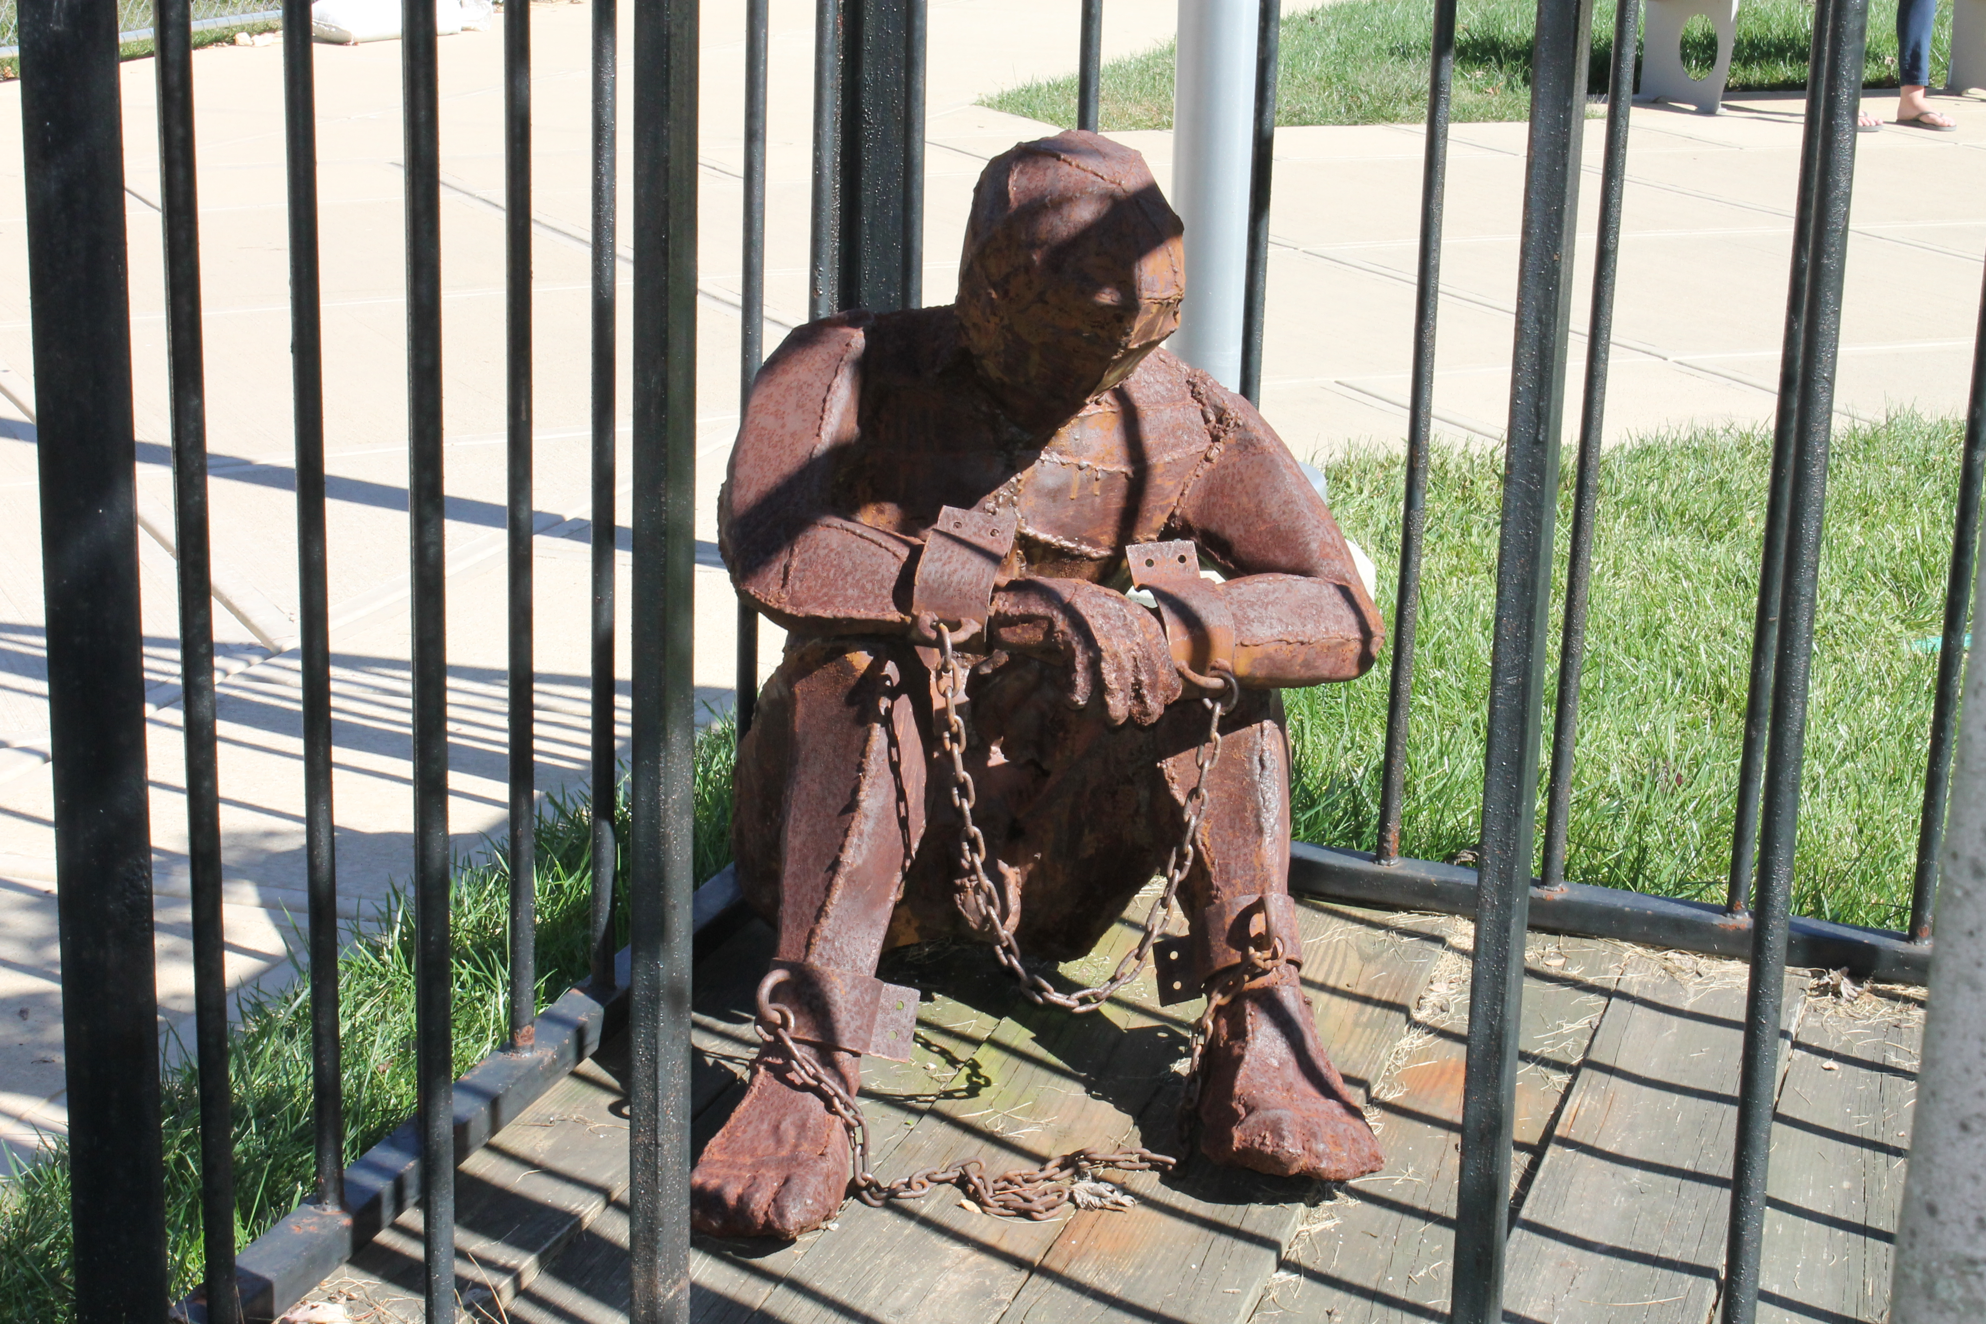

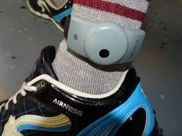
Against E-Carceration?
Electronically Monitoring Offenders and
“Place-Making Practices”
Mike Nellis – University of Strathclyde

Slide 2
What is E-Carceration?
An analytical/polemical term for the use of EM technologies to confine and enclose offenders and (increasingly) some categories immigrant/asylum seeker in manifestly oppressive ways.
Of recent American origin - where EM home detention originated 40 years ago, the usual policy aim being to create “prison-like” environments, more cheaply, in the “community” (Home as “virtual prison” or “jailspace”, tracking as “walking prisons”)
“Challenging E-Carceration” – activist James Kilgore’s Soros-funded campaign against EM-use in the USA, aligned with the “No Digital Prisons” campaign and underpinned by penal abolitionism.

Slide 3
EM – Some Propositions
EM exists in 40* countries and continues to expand (slowly and haphazardly) because of “proven penal utility” AND the normalization of digital governance (and of tracking, tracing and pinpointing in everyday life). Technocultural factors outweigh penal utility.
EM’s “conditions of possibility” lie in the global ICT infrastructure, it customizes prevailing/ever-changing networks of real-time connectivity for penal purposes (punitive, protective and “rehabilitative”). EM tech is not static, “upgrades” likely.
EM is commercially-driven only in the sense “that digitization of everything” is where profit lies. Is it the influence of a “commercial corrections complex” vs the logic of “surveillance capitalism”, or both?
EM is, generically, a form of “coercive connectivity” – in which judicial and penal agents authorize the gathering of location-data (and maybe what can be inferred from such data) in order to enforce spatial and temporal restrictions on defendants/offenders (claimed as proxies for reducing reoffending)
EM can obviously be “carceral” but is not “carceral” by definition (in the polemical sense): the restrictiveness/intensity of the regimes it can be used to create are the outcome of political choices, not inherent in the tech itself (tho’ tech is never neutral!) Europe (even Britain!) made different choices to the USA.

Slide 4
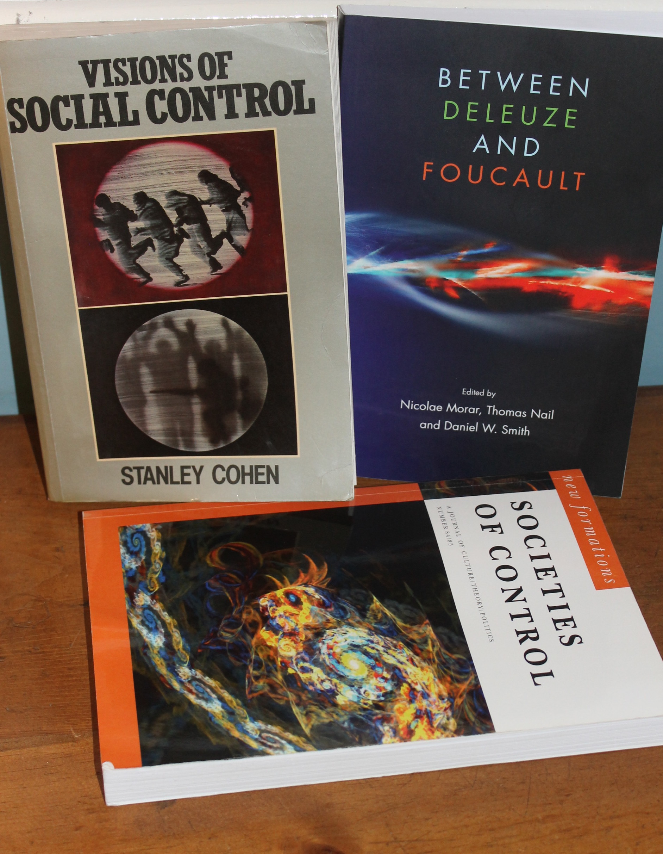
Discipline, Control and Net-thinning
(and Normativity)
Foucault (historically)– “the carceral” entails enclosure: all forms of the carceral entail discipline but not all emerging forms of discipline are primarily carceral.
Deleuze – emerging forms of control (based on information-processing) are not about enclosure and not disciplinary in the Foucauldian sense. Moulding vs modulation.
EM regimes can be either, or hybrids of both and can create much more varied spatial experiences and forms of subjectification than imprisonment can.
“Carceral mobilities” (akin to Stan Cohen’s “net-thinning”?) clearly exist but have to be internally differentiated and normatively appraised as penal strategies against the excess of locks, bolts and bars (“cages”)

Slide 5
James Kilgore’s Picture of “E-Carceration”
(“shackles” are an extension of “cages”)
E-Carceration is real ………
“THE VOICE OF THE MONITORED”
Post-imprisonment GPS tracking is used to enforce home confinement and monitor “authorized absences” (for work, family business).
Authorized absences can be denied or delayed
Obedience, not discipline, is the aim (sovereign power?)
Monitoring deliberately impedes re-integration
Periodic re-imprisonments for minor violations
Subjectively experienced as abjection
This is more immobility enforcement than mobility monitoring.
The mother of a monitored adult son:
“Under his current situation, he must have permission to carry out basic tasks for everyday living and going to the grocery store and visiting the doctor. Even when he requests movement for everyday activities like a haircut, they frequently take several days to respond. Last year they refuse to let him leave the house to be with family on Thanksgiving and Christmas …. He also cannot visit anyone unless he has permission”.

Slide 6
GPS Tracking Regimes Vary
(all require wearing of networked devices, GPS signals and viable mobile phone networks to upload data)
Incessant, real-time or retrospective monitoring of trails
Residence Restrictions (away from schools, parks etc)
Exclusion zones (to protect victims)
Inclusion zones (larger than home)
Curfew requirements (to charge device batteries)
Algorithmic analysis of movement patterns (= virtual, telematic control)
This materially shapes experience of locality.
But how? Control is EM’s rationale but must it be cruel, punitive or oppressive?
What do offenders, victims and communities want? Whose voices get to shape the way EM tech is used?
(Shklovski et al (2009) on monitored sex offenders:
“Expecting to be constantly visible to their parole officers, they adopted routines and limited patterns of motion in an attempt to make their GPS traces legible and somewhat predictable to discourage accusations of parole violation. Reflecting on the importance of routine, one sex offender suggested: “They [parole officers] know your patterns and they track you, and they know when you’re out of your pattern. … it puts suspicion into them”. “
The “voice of the monitored” is not consistent ……..

Slide 7
Voices from the English GPS Tracking Pilots 2017-18
“Whenever I’m released (from custody) the Police are on me. They’re now leaving me alone because they can see I’m not up to anything if they wanted”.
“The GPS tag has kept me on track” (keeping to a routine)
“It’s given me an excuse not to get involved” (with negative peers/criminality)
“It helped me show my family that I had really changed this time”.
“My Offender Manager allowed me to go home rather than an Approved Premises (hostel) because of the GPS tag”
It’s the fact that you can continue to provide support for the people that you care for and you – you can still work, you can still be around, you can still be a brother, a friend, you can still be a dad. You can still be all those things whilst on GPS that you can’t if you’re in custody.
This is not “e-carceration” as James Kilgore experiences it in the USA - which does not make this defensible per se - but weakens a straightforward case for abolition based on EM’s inherent oppressiveness.

Slide 8
EM as a “Place-Making Practice”
Henri Lefebvre’s (1901-1991) term
Lefebvre’s (pre-digital) concern was with political processes for making and sustaining urban spaces (neighbourhoods) accessible, convivial and safe for marginal people, as part of his wider argument about “the right to the city”
“Place-making practices” are now being re-theorized in terms of the user-friendly “locative media” (smartphone-based) that ambient digital infrastructures make possible (for better or worse). So …. can some forms of EM be considered as akin to “locative media”?
Inalienable social questions about censure, constraint, redress in relation to interpersonal violence – Practical Realism always requires them - can be reframed in terms of Lefebvre’s place-making without immediate resort to imprisonment:
  How can street crime be reduced, how can victims be protected, how can offenders be reintegrated? EM is not the primary answer to any of these questions!
But, here, now, in contemporary technoculture … can some forms of EM ever be used to create legitimate and defensible forms of offender regulation and victim protection “in the community” without detriment to the social justice strategies integral to abolitionism. Yes, but …..

Slide 9
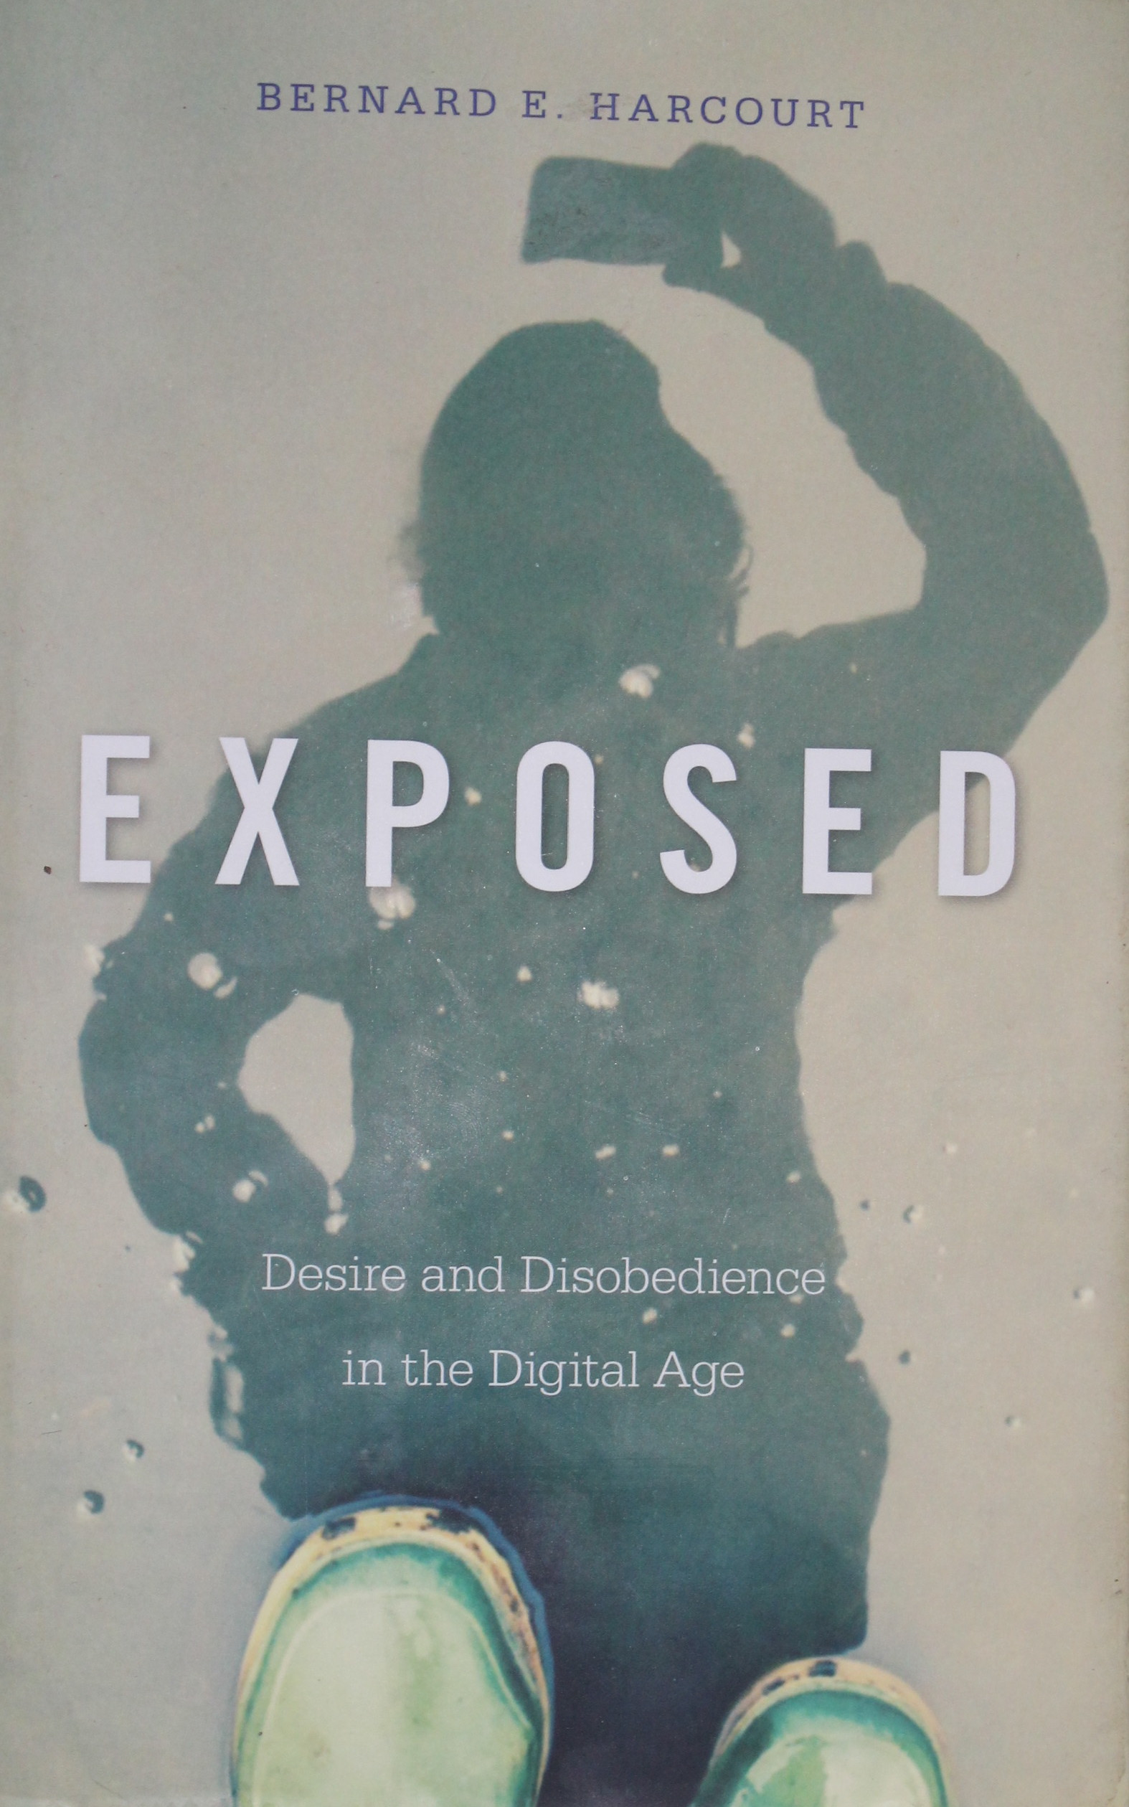
Yes, But ….
Only If There Is Resistance by analysts and activists
The logic of “surveillance capitalism” is towards the datification of everything; the power of tech companies over tech must be weakened.
The latent tendency of EM tech – originating outside all liberal penal reform traditions –could well be towards e-carceration. Resist it.
Resistance to EM necessarily occurs with a technoculture where ubiquitous connectivity has been embraced and normalized ….
….. So complete abolition is unlikely (and would probably benefit imprisonment)
Prefigurative forms of real alternatives to prison which deal differently with censure, constraint and redress and undermine the material and symbolic power of imprisonment are needed.
Use of EM in immigration policy is much less defensible - if the whereabouts of migrants must be known, a stable home and a welcoming neighbourhood beats EM.
Combine “social shaping of technology” with “place-making practices” to create defensible forms of EM which are not “prison-like” (in a spirit utopian realism).
Subordinate EM to human rights, humanistic probation values and an ethic of care. No mass use, no lifetime tracking, no e-carceration.
Invoke ethics of technology-use; ask how far we want digital encroachment to reach in our lives. Resistance must be site-specific. The “penal field” is one such site.
Even if EM is conceived as as “attenuated carcerality” normative distinctions must be made between legitimate and illegitimate uses. Without this, viable resistance is not possible.
“On the street”, it is necessary to be “brokers in lesser evils”

Slide 10

Thank you
I’d like to say
none of this is rocket science
but, of course, some of it is!
mike.nellis@strath.ac.uk

