Slide 1
Prison conditions:
Normalisation, wellbeing and contact with nature
Dominique Moran
University of Birmingham
@drdommoran

Slide 2
Prison conditions: Normalisation, wellbeing and contact with nature
Projects
Prison conditions
Normalisation – ‘inside’ and ‘outside’
Wellbeing and Attention Restoration Theory
  Effects of nature contact

Slide 3

Projects:
Prison architecture, design and technology and the lived experience of carceral spaces.
3.5 year ESRC project with Yvonne Jewkes, Jennifer Turner and Ellie Slee
  Why do we build prisons as we do (in the UK and Scandinavia)?
  (How) Do they communicate punitive philosophies?
  How are they experienced by those who live and work in them?
Attention Restoration Theory and nature contact in prison
6-month ESRC IAA ‘impact’ project
  What difference does nature contact make to prisoners’ wellbeing?
  How effective is ART for understanding the effect of nature contact in prison?

Slide 4
Project: Prison architecture, design and technology and the lived experience of carceral spaces.
“The design of a jail or prison is critically related to the philosophy of the institution, or maybe even of the entire criminal justice system. It is the physical manifestation of a society’s goals and approaches for dealing with arrested and/or convicted men and women, and it is a stage for acting out plans and programs for their addressing their future”
Wener (2012: 7)

Slide 5
Project: Prison architecture, design and technology and the lived experience of carceral spaces.
Data generation at HMP Grampian, UK; Halden, Norway, and with prison architects, construction engineers etc. in Norway, Denmark, Spain, UK, etc.
Contrasting (and changing) policy context
  England and Wales (arguably…) moving from punitive towards rehabilitative
  Nordic region (arguably…) steeped in normalisation and humane principles of confinement

Slide 6
Prison conditions
83-84,000 prisoners in England and Wales (79,000 male, 4,000 female)
System runs very close to capacity (of 85,616). Approximately half live in ‘crowded conditions’ (i.e. two in a space designed for one)
c117 establishments, with populations ranging from 1-200, to over 1500
Prison estate varies in age, from Victorian (e.g. HMP Birmingham, Leicester) to under-construction
However, across the estate, environments are fairly similar, in part due to security and technical standards driving construction of standardised accommodation.
Long-term concerns for living standards – recent media attention drawn to poor HMIP inspection reports, noting dilapidation, infestation, mould, poor sanitary conditions, etc.

Slide 7
Prison CONDITIONs
Noisy – prisons are ‘live’ spaces where noise reverberates off hard, reflective surfaces.
There is overly-bright, hard-edged sound, with excessive echoes.
Noise sources include constantly bleeping alarms, clanging gates, rattling keys, and lots of shouting.
HMP Altcourse

Slide 8
Prison conditions
Smelly – prisons are generally poorly ventilated. Security concerns mandate limitations on window-opening, so inhabitants have very little control over the ventilation of their cells. Steel mesh and ‘trickle vents’ are common. (Smoking recently banned.)
Hot – recently-built prisons are well-insulated and being poorly ventilated, during hot weather they fail to shed heat at night. Such buildings are sweaty and uncomfortable.

Slide 9
Prison conditions
Sanitation – almost all prisons now have an in-cell WC, and many have in-cell showers.
These often have an unscreened or inadequately screened lavatory, frequently without a lid, or sometimes with a makeshift lid made of cardboard, pillowcases or food trays.
In these same cells, prisoners are frequently required to eat all their meals – in what are obviously insanitary, unhygienic and degrading conditions. (HMIP 2017, 3)
When a toilet is flushed germs from the toilet bowl can travel as far as six feet, landing on the floor, the sink and other items within range. (ibid, 17)
Johnson, D. L., Mead, K. R., Lynch, R. A. and Hirst, D. V. L. (2013) ‘Lifting the lid on toilet plume aerosol: A literature review with suggestions for future research’, American Journal of Infection Control 41, 254–258; Barker, J. and Jones, M. V. (2005) ‘The potential spread of infection caused by aerosol contamination of surfaces after flushing a domestic toilet’, Journal of Applied Microbiology 99, 339–347.
Toilet in cell in Pentonville (2015)
Unscreened toilet where prisoners ate their meals in HMP Birmingham, 2017

Slide 10
Prison conditions
Nature contact – many prisons are devoid of green space or green views within the walls/fence.
Victorian local prisons are on tight urban sites
Expansion of the estate has meant in-filling on existing sites (e.g. HMP Isis at HMP Belmarsh)
More spacious sites tend to use tarmac rather than grass, and grass tends to be in ‘sterile’ areas
Other than from high floors which look over the wall, views from cells are of this austere environment
As a result, prisoners tend to lack nature contact

Slide 11
Nature contact
Good for us – ‘green infrastructure’
Spending time in green spaces is good for our mental health, as well as our physical health
Some evidence that green spaces have the greatest effects for people with the poorest mental and physical health
Lack of nature contact a recognised problem in prison – beginning to speak of it as a ‘pain’ of imprisonment after Sykes.

Slide 12
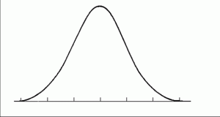
what ‘Should’ prison be like?
A ‘less eligibility’ thesis held sway until the 19th century:
“..to deter the rational offender requires the pain of punishment to outweigh the pleasures derived from the crime…. [such that] the upper margins of prison conditions are guaranteed not to rise above the worst material conditions in society as a whole and that, in times of social hardship, the rigours of penal discipline will become more severe to prevent the weakening of its deterrent effect” (Scott 2007, 50-51)
prison
conditions
‘society
as a whole’

Slide 13
What ‘should’ prison be like?
Shift from ‘less eligibility’ to a rehabilitative approach by 1920s – intention to enable prisoners to ‘lead a good and useful life’
1960s – crisis of containment in the UK – high profile escapes – emphasis on discipline, surveillance and control
1970s – ideas of ‘positive custody’ – but vague
1980s – ‘humane containment’ lexicon with ‘normalisation’ including ‘living standards equivalent to those on state welfare’
1991 - Woolf Report – response to riots – emphasis on justice and ‘normalisation’
1990s – revival of ‘prison works’, and resurgence of ‘less eligibility’ under Conservative government
1997+ - revival of rehabilitative focus, but under new public managerialism
Now – revival of ‘normalisation’

Slide 14
Normalisation
International Covenant on Civil and Political Rights; Article 10.1
All persons deprived of their liberty shall be treated with humanity and with respect for the inherent dignity of the human person.
UN Standard Minimum Rules for the Treatment of Prisoners (Nelson Mandela Rules)
Rule 3:
Imprisonment and other measures that result in cutting off persons from the outside world are afflictive by the very fact of taking from these persons the right of self-determination by depriving them of their liberty. Therefore the prison system shall not, except as incidental to justifiable separation or the maintenance of discipline, aggravate the suffering inherent in such a situation.

Slide 15
Normalisation
Finland: Sentences Enforcement Act
“Punishment is a mere loss of liberty: The enforcement of sentence must be organised so that the sentence is only loss of liberty. Other restrictions can be used to the extent that the security of custody and the prison order require.
Normality: The circumstances in a penal institution must be organised so that they correspond to those prevailing in the rest of society.”

Slide 16
Carceral geography; inside and outside
How do we understand the relationship between what lies ‘inside’ and ‘outside’ the prison?
The carceral delivers ‘forms of confinement that burst internment structures and deliver carceral effects without physical immobilization’
‘Carceral’ spaces beyond prisons
Discourses of ‘normalisation’ speak directly to these issues of separation and difference between ‘inside’ and ‘outside’
Think through this relationship…

Slide 17
Normalisation
“the process of bringing or returning something to a normal condition or state”
Normalising prison? Making prison ‘normal’?
becomes ‘normal’ for people experiencing it
PRISON
starts to resemble ‘normal’ life ‘outside’

Slide 18
Prison becomes ‘normal’ for people experiencing it
Familiar concept of ‘institutionalisation’ – in terms of infantilisation, dependency, etc.
Spaces matter:
    prisoners accustomed to communal accommodation struggle to adapt to smaller living units
    prisoners are often accustomed to a constant hum of noise, or constant lighting – disorientation
    relatively unchanging prison environment means prisoners become accustomed to ‘sameness’ rather than to changing environments more familiar on the ‘outside’

Slide 19
“I began to think, that after the noise, I felt the silence as a burden. I’d lie awake, unable to sleep, and feeling tense. And the silence started to really get to me. I’d turn on the TV, put music on in the kitchen, so that there was some noise. I still couldn’t sleep. I’d walk around the apartment, into the living room, into the bedroom, like a hunted animal, but the only thing I could do was go outside, so I’d go out into the street. I got dressed and ran out into the street where there were people about. I just couldn’t sit at home.”
What is “normal”?
For whom?
When?

Slide 20
HMp Liverpool (1855)
HMP Liverpool: inspection 2017
“squalid living conditions”, “lavatories… filthy, blocked or leaking”, “infestations of cockroaches”, “piles of rubbish”, “rats”
1850s Liverpool
“Squalid and unhygienic… without water or sanitation”, “rotting rubbish clogged its alleys”
Was HMP Liverpool once ‘normal’?

Slide 21
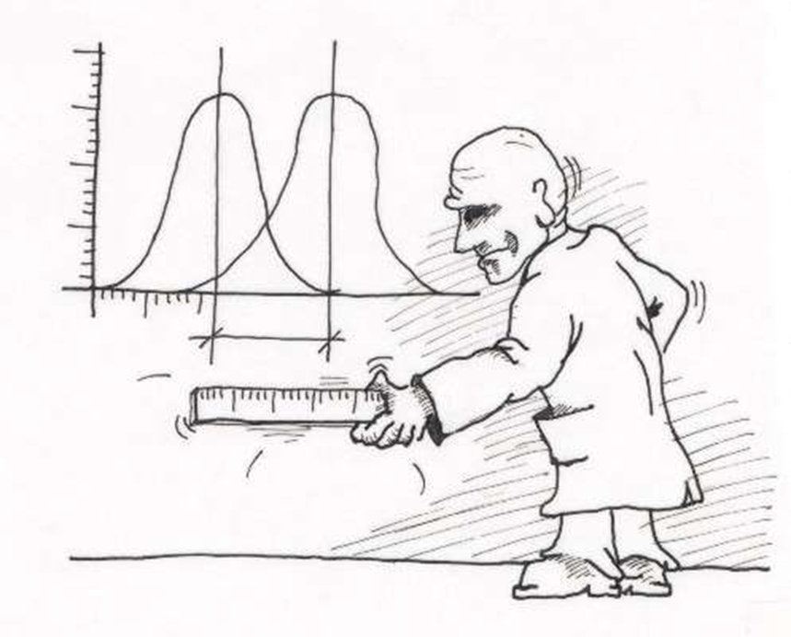
What is ‘normal’ and how do we compare it?
How do we compare two things?
Conventionally, by comparing the averages of two groups of things…
But first we have to know what we are measuring…
And the groups of data will deviate internally…

Slide 22
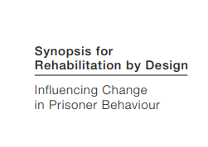
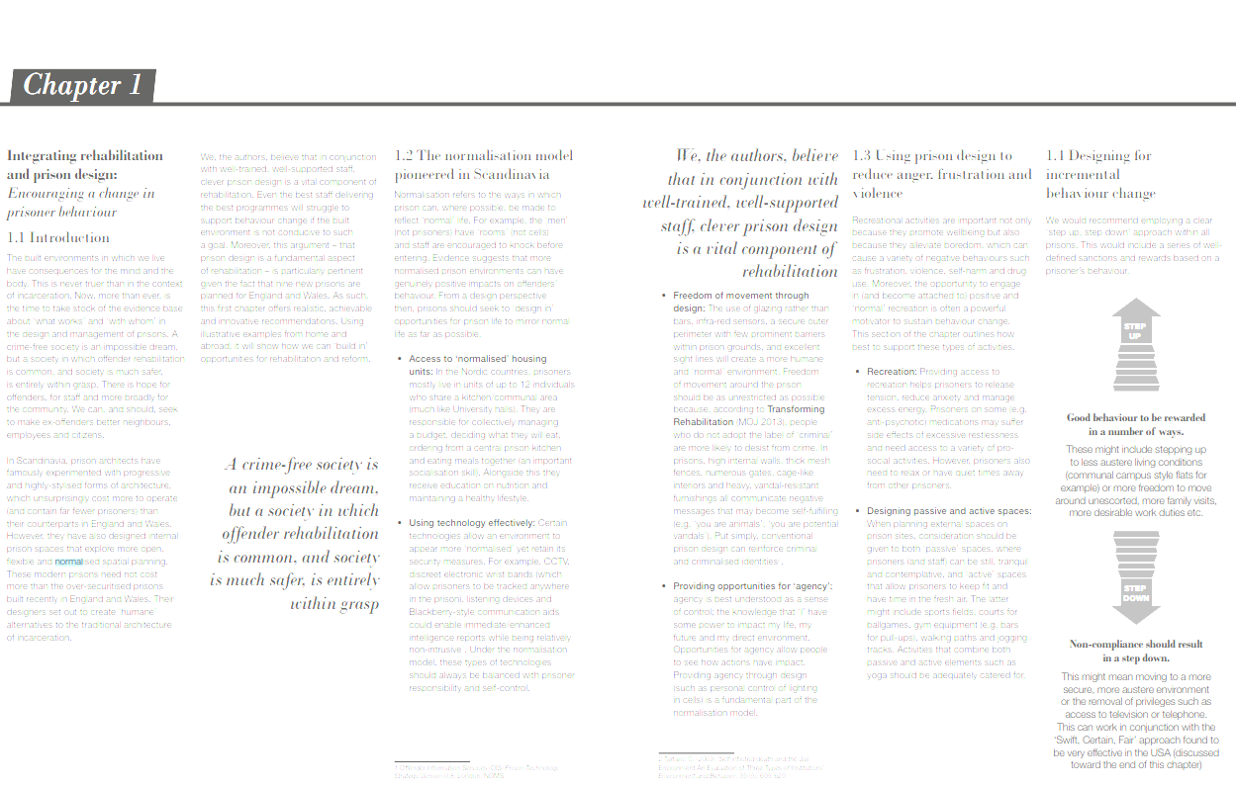
What does normalisation in prison look like?
“Evidence suggests that more normalised prison environments can have genuinely positive impacts on offenders’ behaviour. From a design perspective then, prisons should seek to ‘design in’ opportunities for prison life to mirror normal life as far as possible.”
[In the Nordic region] ‘internal prison spaces that explore more open, flexible spatial planning, seeking to mirror more closely ‘normal’ life outside the prison….. prisoners mostly live in units of up to 12 individuals who share a kitchen/communal area (much like University halls)’
…rather than…
“high internal walls, thick mesh fences, numerous gates, cage-like interiors and heavy, vandal-resistant furnishings [which] all communicate negative messages that may become self-fulfilling (e.g. ‘you are animals’; ‘you are potential vandals’)”.

Slide 23
Whose “normal” is this?
For whom is it normal to “live in units of up to 12 individuals who share a kitchen/communal area (much like University halls)”? Is it ‘normal’ to go to University?
‘Normal’ is used to describe individual behaviour that conforms to the most common behaviour in society. Which society? Is what’s ‘normal’ for Denmark different from what’s ‘normal’ for the UK? Do Danish prisoners ‘need’ different conditions from UK prisoners? What about Foreign National Prisoners?

Slide 24
What is prisoners’ own “normal”?
Many prisoners have a history of social exclusion, being more likely than the general population to have grown up in care, poverty, and to have had a family member convicted of a criminal offence (Social Exclusion Unit (SEU), 2002; Ministry of Justice, 2010a).
The United States currently has more than 2 million people locked up in jails and prisons. A disproportionate number of them come from a very few neighborhoods in the country’s biggest cities.
The neighborhoods from where the most people are sent to prison are the same ones where there’s high unemployment, frightening numbers of traumatized children, and emergency rooms that are over-used for primary care.
(Million Dollar Blocks; Justice-Mapping Project)

Slide 25
“high internal walls, thick mesh fences, numerous gates, cage-like interiors and heavy, vandal-resistant furnishings [which] all communicate negative messages that may become self-fulfilling (e.g. ‘you are animals’; ‘you are potential vandals’)”

Slide 26
What is prisoners’ own “normal”?
“Black men who dwell in the [housing] projects … have their performances of masculinity shaped by the ubiquitous carceral world that surrounds them. Indeed, they are ‘‘prepared for prison’’ through the deployment of carceral forms into their everyday life.”
“Robert Taylor was the epitome of the carceral mise-en-scéne….Of all the high-rise projects built in the postwar period, it resembled prison the most. …. Units were contained in twenty-eight identical sixteen-story buildings, grouped in a U-shape formation, encircled with ‘‘cages of meshed wire.’’”
(Shabazz 2009; 278,285)

Slide 27
What is prisoners’ own “normal”?
What does this mean?
Is it OK for prisons to resemble housing projects because housing projects resemble prisons?
Comparing prison with the outside world, even if the two can be thought separate from one another, is fraught with difficulty.
Normal can’t be defined, (and neither can prison).

Slide 28
Are comfortable prisons ‘normal’?
Prison architects in the Nordic region described less of a tension between conditions outside and conditions inside – and a higher degree of tolerance of the idea that prison conditions could be ‘aspirational’.
i.e. that there was perhaps some therapeutic benefit in providing prisoners with conditions that were better than those from which they had come.
In societies of extreme and ever-widening social inequality, to what should prison be compared?

Slide 29
Normalisation and “less eligibility”
Complaints about prison being ‘too soft’ are often made alongside statements about life outside being ‘too hard’, especially in a context of austerity and public service cuts
“Jails care for criminals better than hospitals care for our elderly”
“It’s shocking, people are living in poverty and they [prisoners] are living in excellent clean conditions with a doctor and physiotherapy on call.”
“We rely on handouts like second-hand toys yet prisoners get the latest models. Our families have to wait ages for counselling, yet prisoners don’t.”
Prison designer, UK: “We can’t give them anything too nice because the people who are living in the area around will see that they’ve got something better than they have. So we’ve kind of got to downgrade it…”

Slide 30
Beyond the inside/outside binary - wellbeing
Rather than try to decide what is ‘normal’, and comparing ‘inside’ and ‘outside’ through the lens of ‘normality’, focus instead on conditions which promote wellbeing:
Treating incarcerated people as people, first and foremost
Considering nature contact.

Slide 31
Attention Restoration Theory
All about recovery from directed attention fatigue (Kaplan 1995)
Two modes of attention –
Directed is the volitional and effortful control of attention – necessary for ‘reasonable’ conduct, and for engagement in education, concentration on tasks, and complex cognitive processes. Depletion over time leads to mental fatigue, impulsivity, irritability and unreasonableness, increasing likelihood of missing subtle social cues and making mistakes, and impairing capacity to make and follow plans. Its restoration requires:
Effortless attention - without sustained effort or conscious control

Slide 32
restoration
Being away - departure from attentionally-fatiguing activities; taking a break from usual contexts
Extent - content and structure to occupy the mind for long enough to allow directed attention to rest
Fascination - effortless capturing of attention – ideally ‘soft’ fascination, enabling reflection
Compatibility - a fit between an individual’s purposes or inclinations, and the activities supported
Transactional nature – between qualities of the environment and a person’s past experiences and current state

Slide 33
Nature contact
Restorative – by delivering all four of the ART constructs
Thought to be positive in prison (Nadkarni et al 2017, Moran & Turner 2018)
Three contact types – direct (i.e. with ‘wild’ nature), indirect (i.e. with parks and gardens), vicarious (i.e. with images, film, etc)

Slide 34
Attention Restoration Theory and nature contact in prison
Anonymous self-completion survey of prisoners at a new prison in the UK
Adapted the Perceived Restorativeness Scale (PRS) (Hartig et al 1997) to ‘test’ for ‘Being away’, ‘Fascination’ and ‘Compatibility’, with open-ended questions probing ‘Extent’ – in relation to green spaces and nature images

Slide 35
Green spaces and nature images
General agreement that both were calming, and provided a sense of ‘normality’
Both enabled ‘being away’ and ‘fascination’ more effectively than ‘compatibility’ – as expected
Green spaces were considered more ‘like those outside’ than nature images, and delivered ‘normality’ more effectively
Probably a function of prisoners’ urban backgrounds, and prior experience of exposure to nature – not probed in depth in the survey.

Slide 36
Being away, Fascination, Extent, Compatibility
“Having green areas makes a huge difference compared to concrete, hard finishes. The main difference is that it takes away the feeling of prison.”
“They help me take my mind away from [this prison] and prison in general… most people don't want to be in prison and can put themselves in the image.”
“Feelings of calm, as a focal point on natural scenes and distract from the daily grind of prison life. I really enjoy the images and find myself picturing being in that place, mountain, seaside etc.”
“On [named] unit, the image is of [local landscape feature] and I quite often look at it and get lost in thought. It's good to daydream about the picture - from the rushing water to the non-rushing traffic due to a slow vehicle going up the hill. Awesome to look - like others I have seen in communal areas and stairways etc”.

Slide 37
Being away, Fascination, Extent, Compatibility
“These images make a difference, because every time I look at them I don’t just think ‘Oh that looks nice’ - I can feel the wind flapping my jacket. I can hear my dog barking. I can smell the fresh air. I can feel the grass on my feet. It makes me imagine and dream. It gets me out of jail for however long. Every time I look at it I notice something that I couldn't see before.”
“I've had numerous conversations with people sitting on the landings talking about these images. The question I always ask is ‘If you was there now, what would you be doing?’ Everyone I spoke to have all got good imaginations and it brings good happy emotions. It's a break from the usual prison politics.”

Slide 38
Wellbeing and normality
Green space and nature images seem to contribute to self-reported wellbeing
Does it matter if they enable a feeling of ‘normality’ or not?
‘Extinction of experience’ thesis argues that lack of nature contact (in ‘normal’ life) means people value nature less and are less motivated to protect the natural environment
To what extent does benefit deriving from nature contact depend on previous experiences?
Carceral geography well-placed to address these questions

Slide 39
Normality and wellbeing
‘Normalisation’ (in its second interpretation) has driven positive changes, but the issue of comparison between inside and outside is a problem…
…particularly because for many incarcerated persons, ‘normal’ is not itself supportive of wellbeing
Since the normative ‘normal’ is usually something different from many prisoners’ own ‘normal’…
… is it better to focus on wellbeing itself, and to consider how to best deploy findings in the custodial environment?

