Slide 1
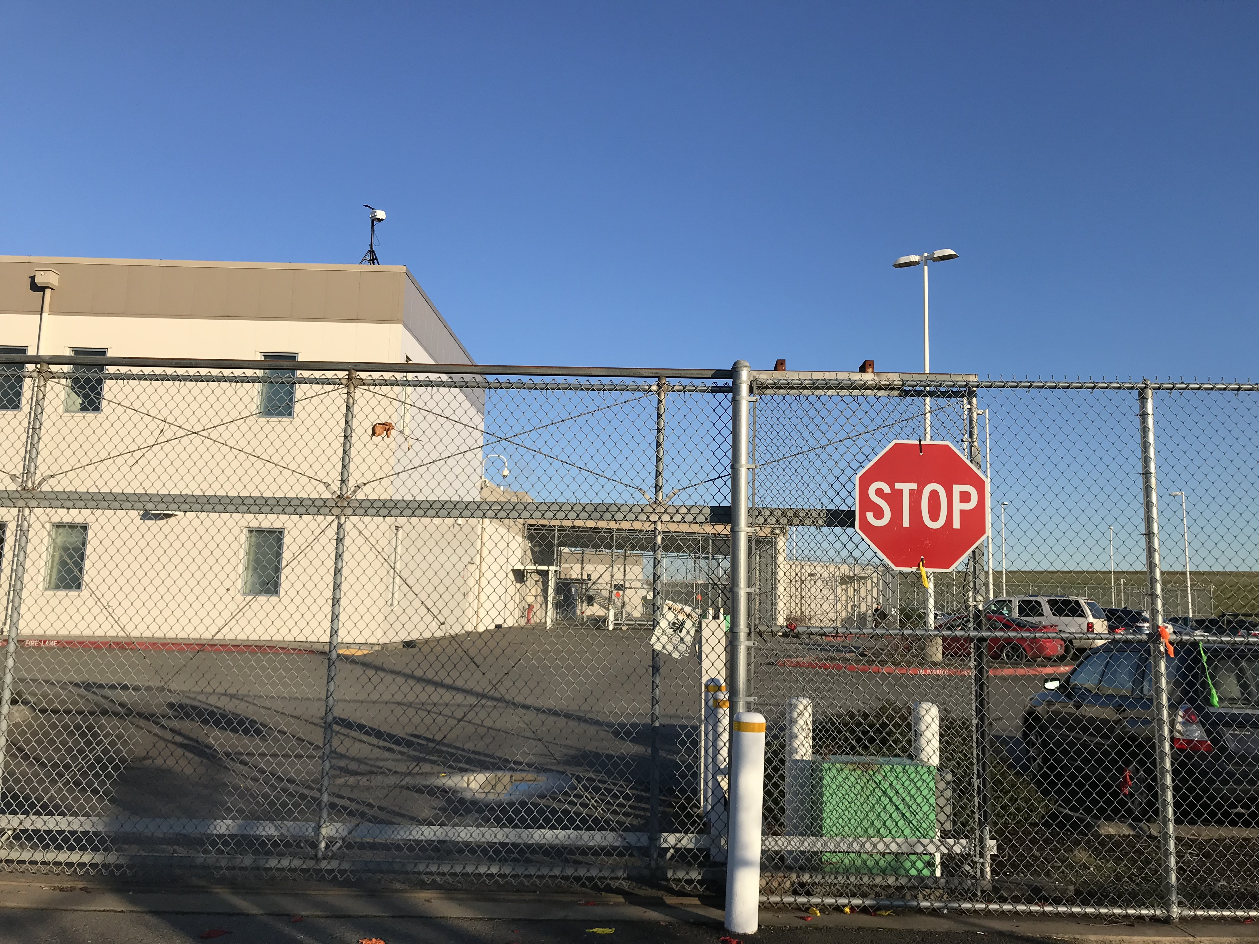
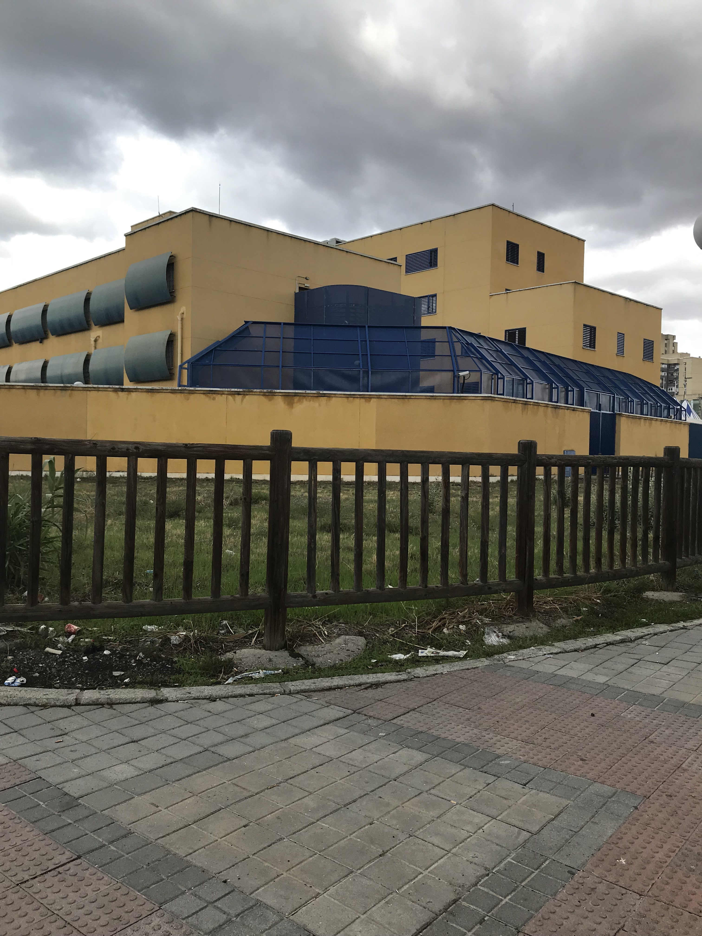
Carceral Landscapes in Spain and the US:
A Contrapuntal Photographic Essay

Slide 2
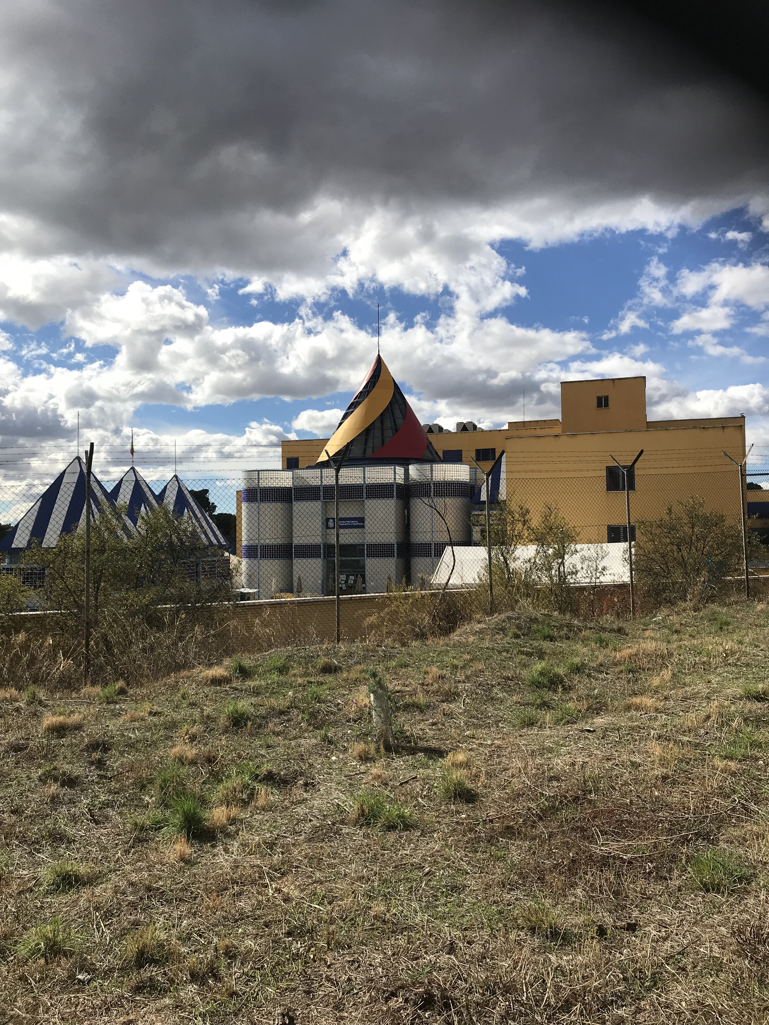
CIE Aluche Madrid

Slide 3
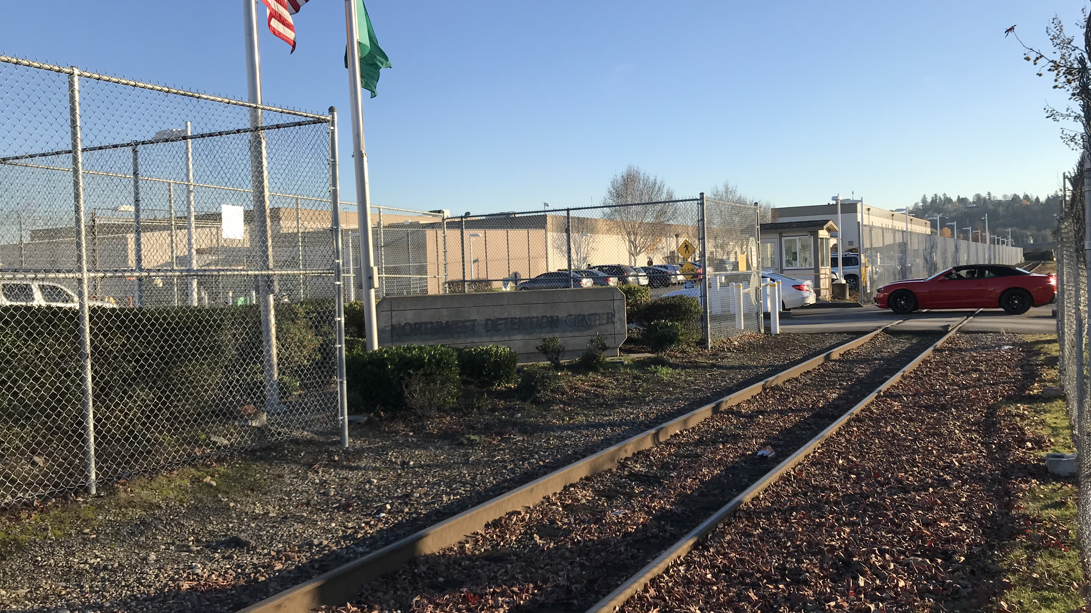
Northwest Detention Center Tacoma

Slide 4
A little bit of housekeeping:
Comparison
Bracketing off geopolitics, legal contexts, bordering practices
Focus on: the landscape itself, and the spatial struggles involved in these sites
Historical-geographical materialism of the prison site (Loyd & Mountz’s Boats, Borders and Bases (2018) and Gilmore’s Golden Gulag (2007)
Why a photo essay

Slide 5
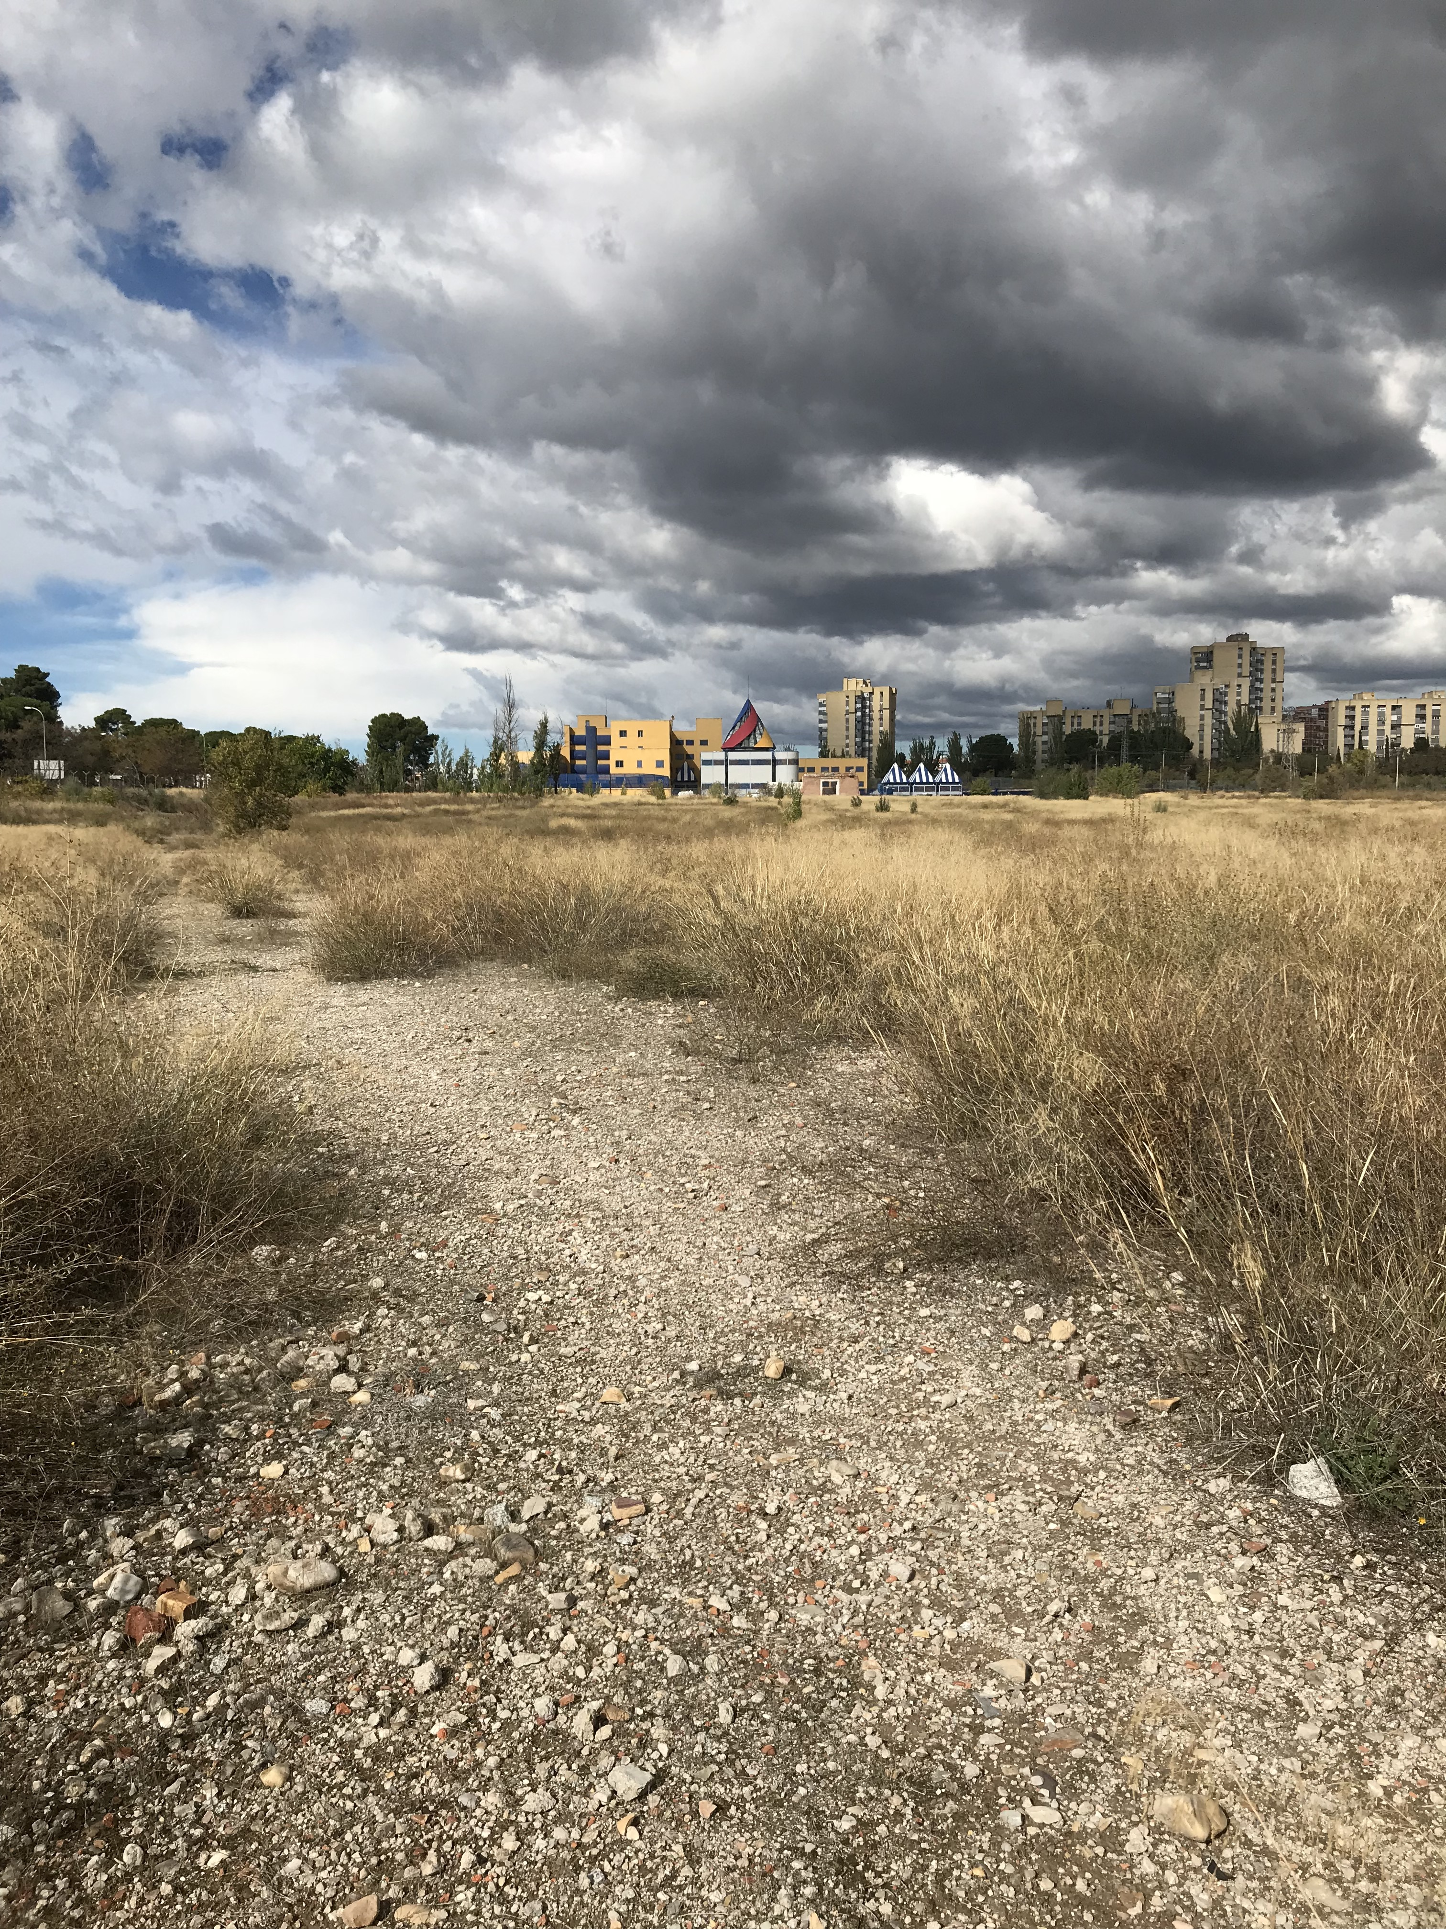

Slide 6
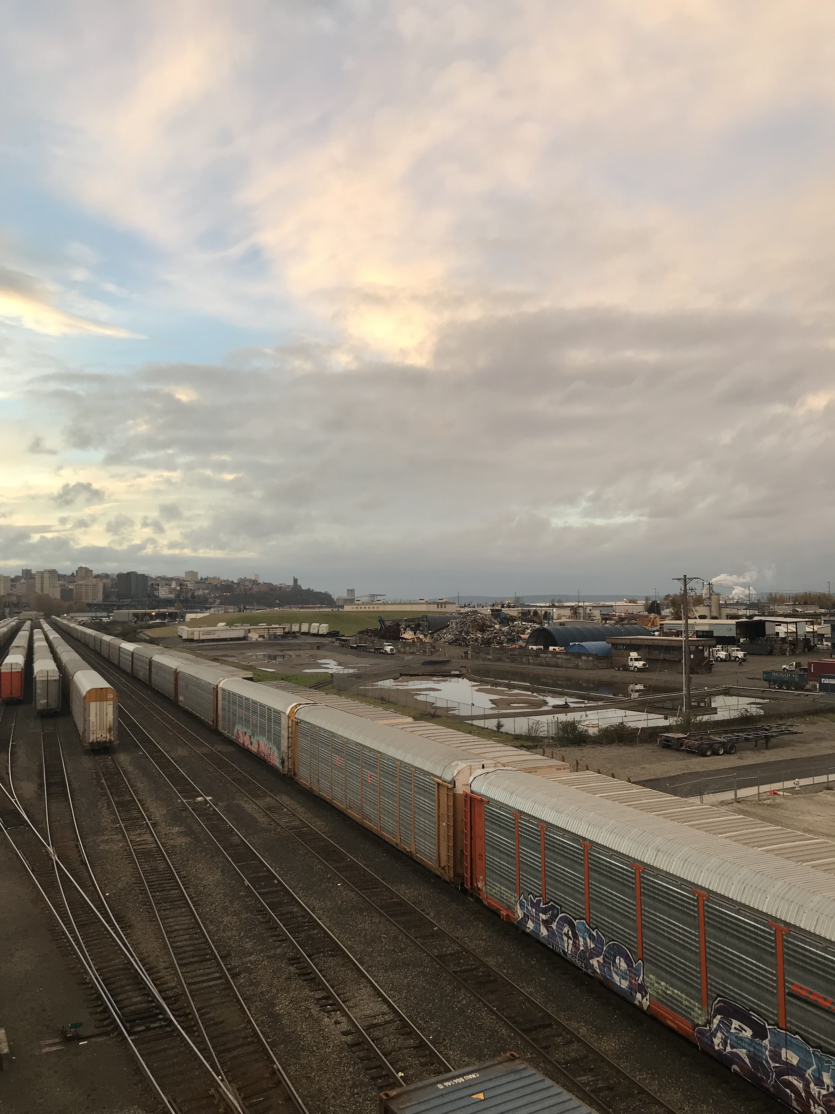

Slide 7
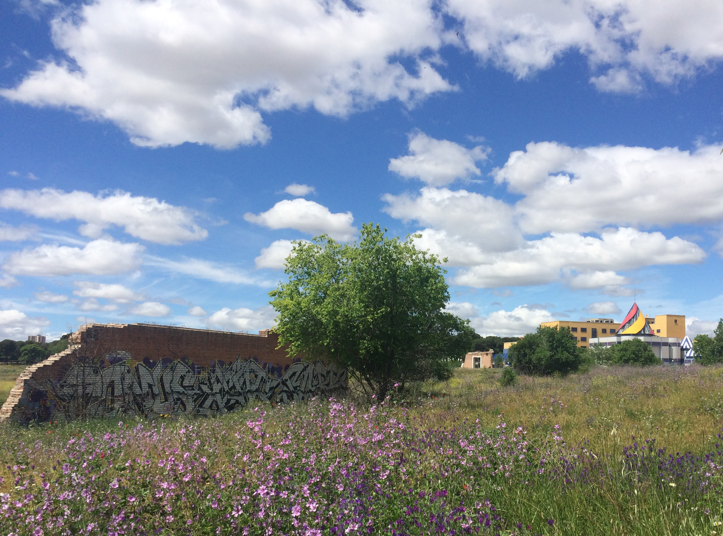
“It isn’t true that public use is being rejected or not taken into account... They are going to dedicate 23,000 square meters to green space; 38,000 square meters to public facilities, 5,000 square meters to infrastructure services, and in addition I want to tell you that they will create an immigration detention center.”
– Ministerio del Interior Mayor Oreja, 1999

Slide 8
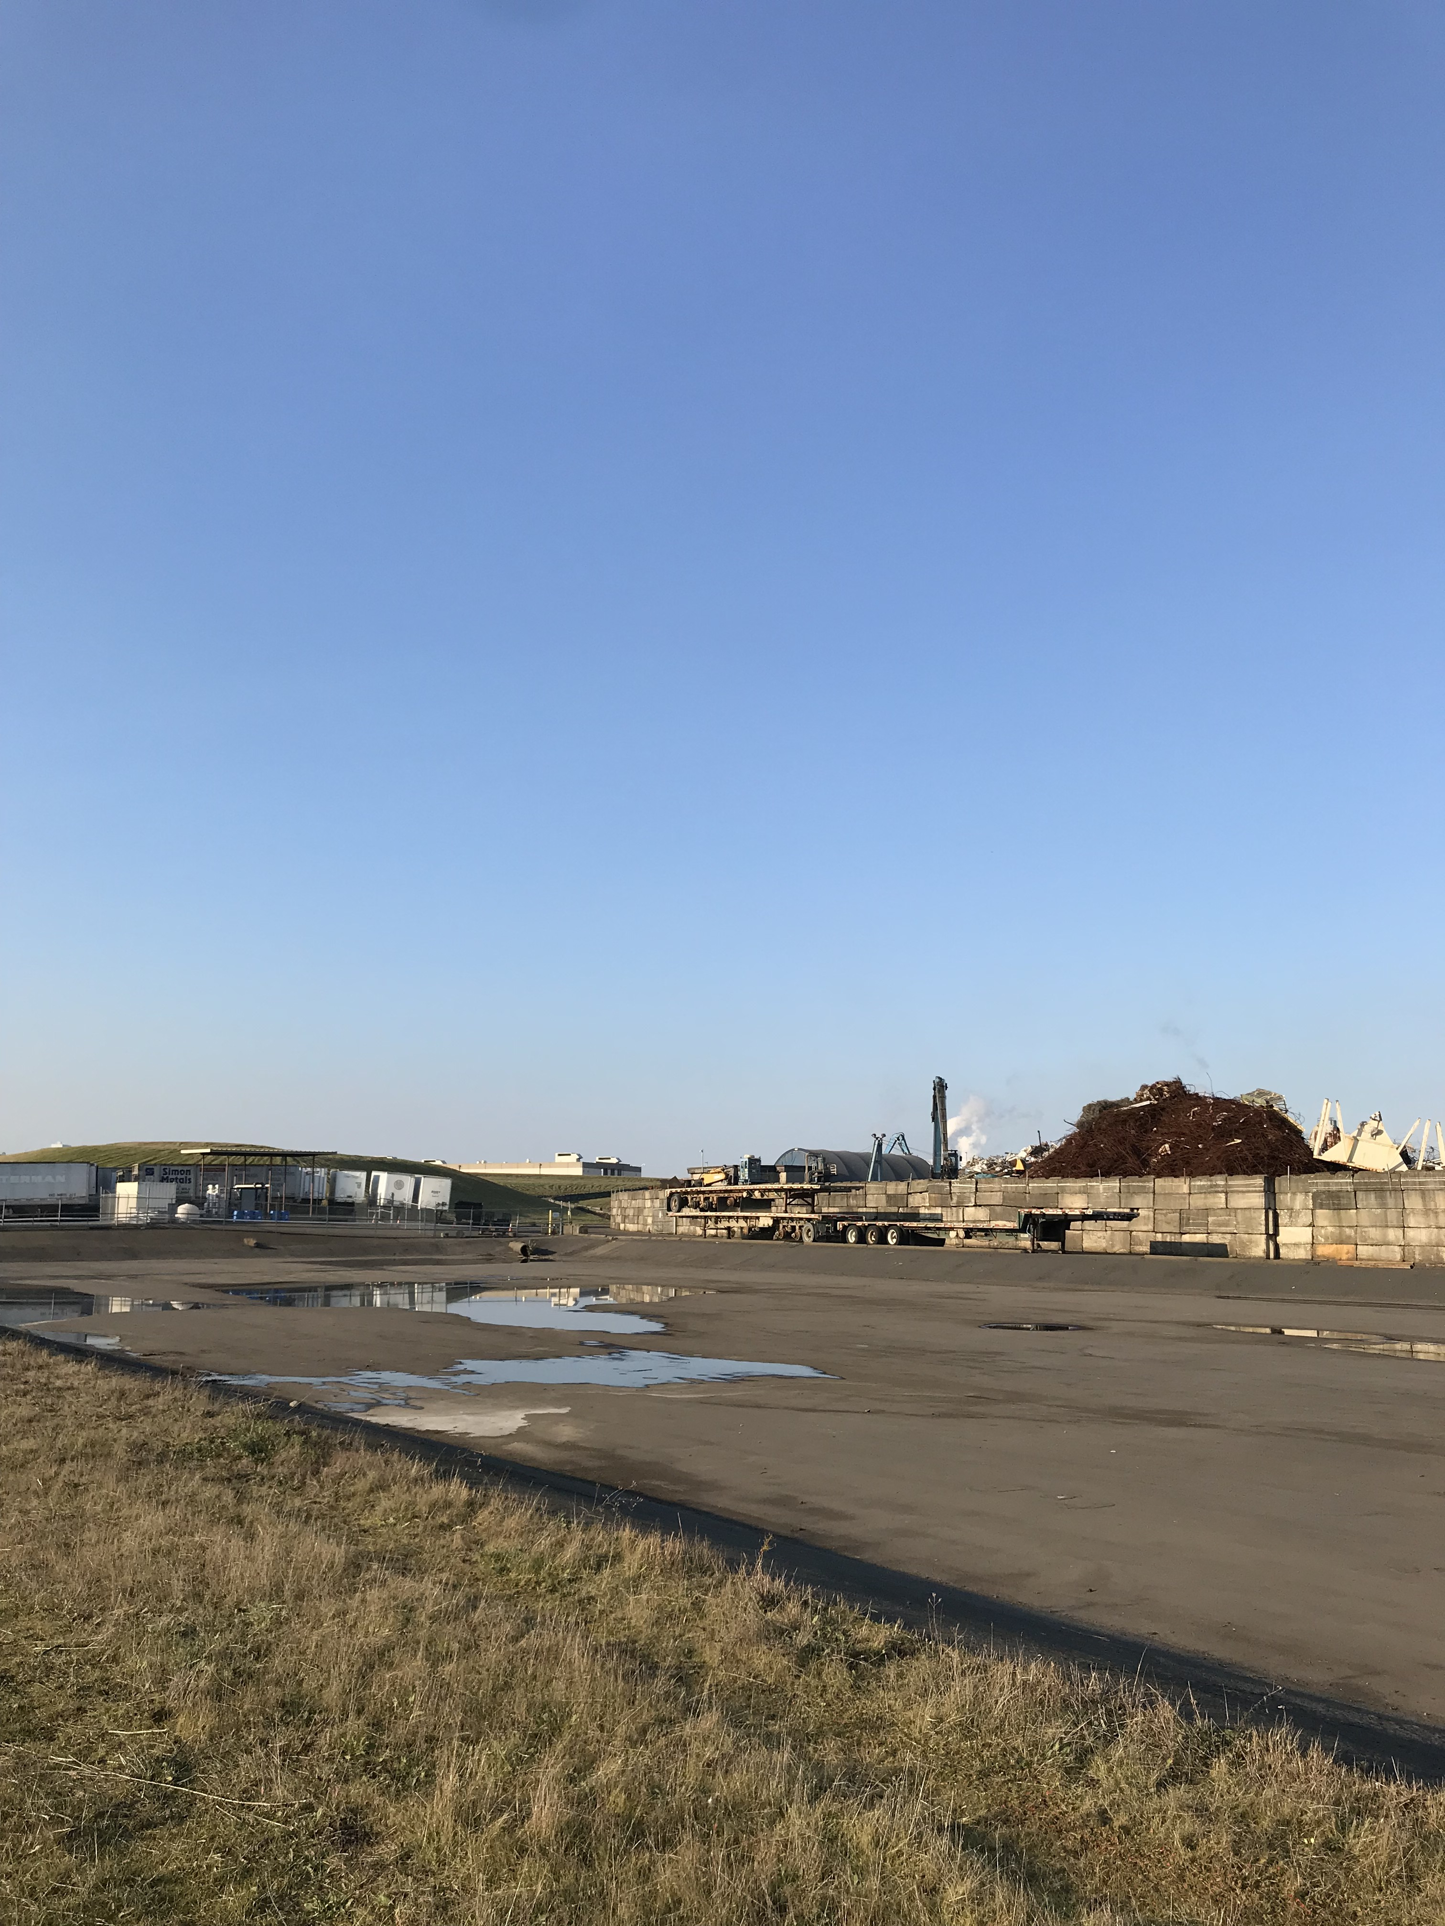
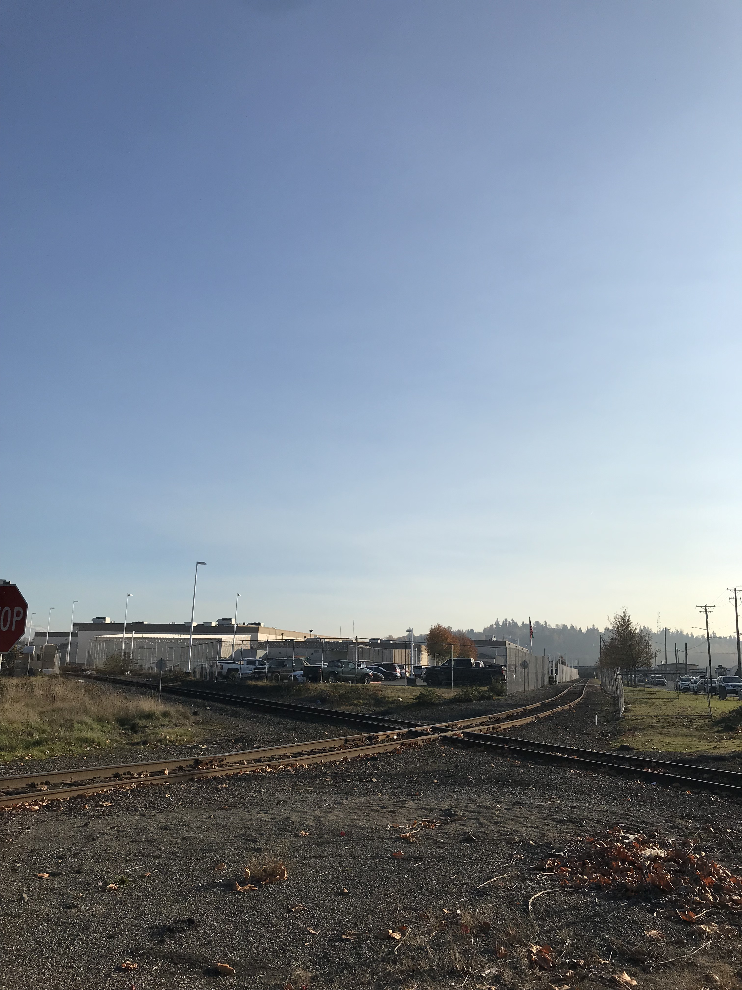
"Redeveloping the property in the manner described above will take an underutilized industrial property and return it to productive use.”
-Landau and Associates, environmental consulting firm, 2000

Slide 9
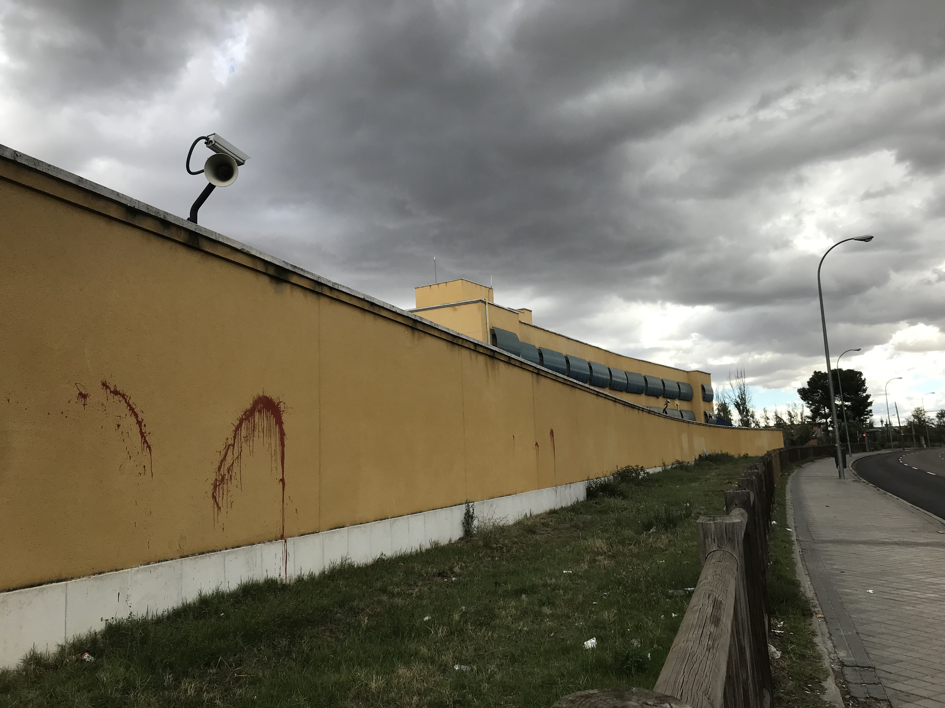
"Look, the biggest success (that is very tiny) is, first of all, that people know that there are detention centers… In the winter of 2016, with the protest that the guys who got on the roof of the detention center during a Real Madrid match. So there, a lot of people found out, because it was they who went out there with a banner saying ”We are people”, “We want rights”, ”We want freedom”, to show them.”
-”Dolores”, anti-detention activist, Madrid, 2018

Slide 10
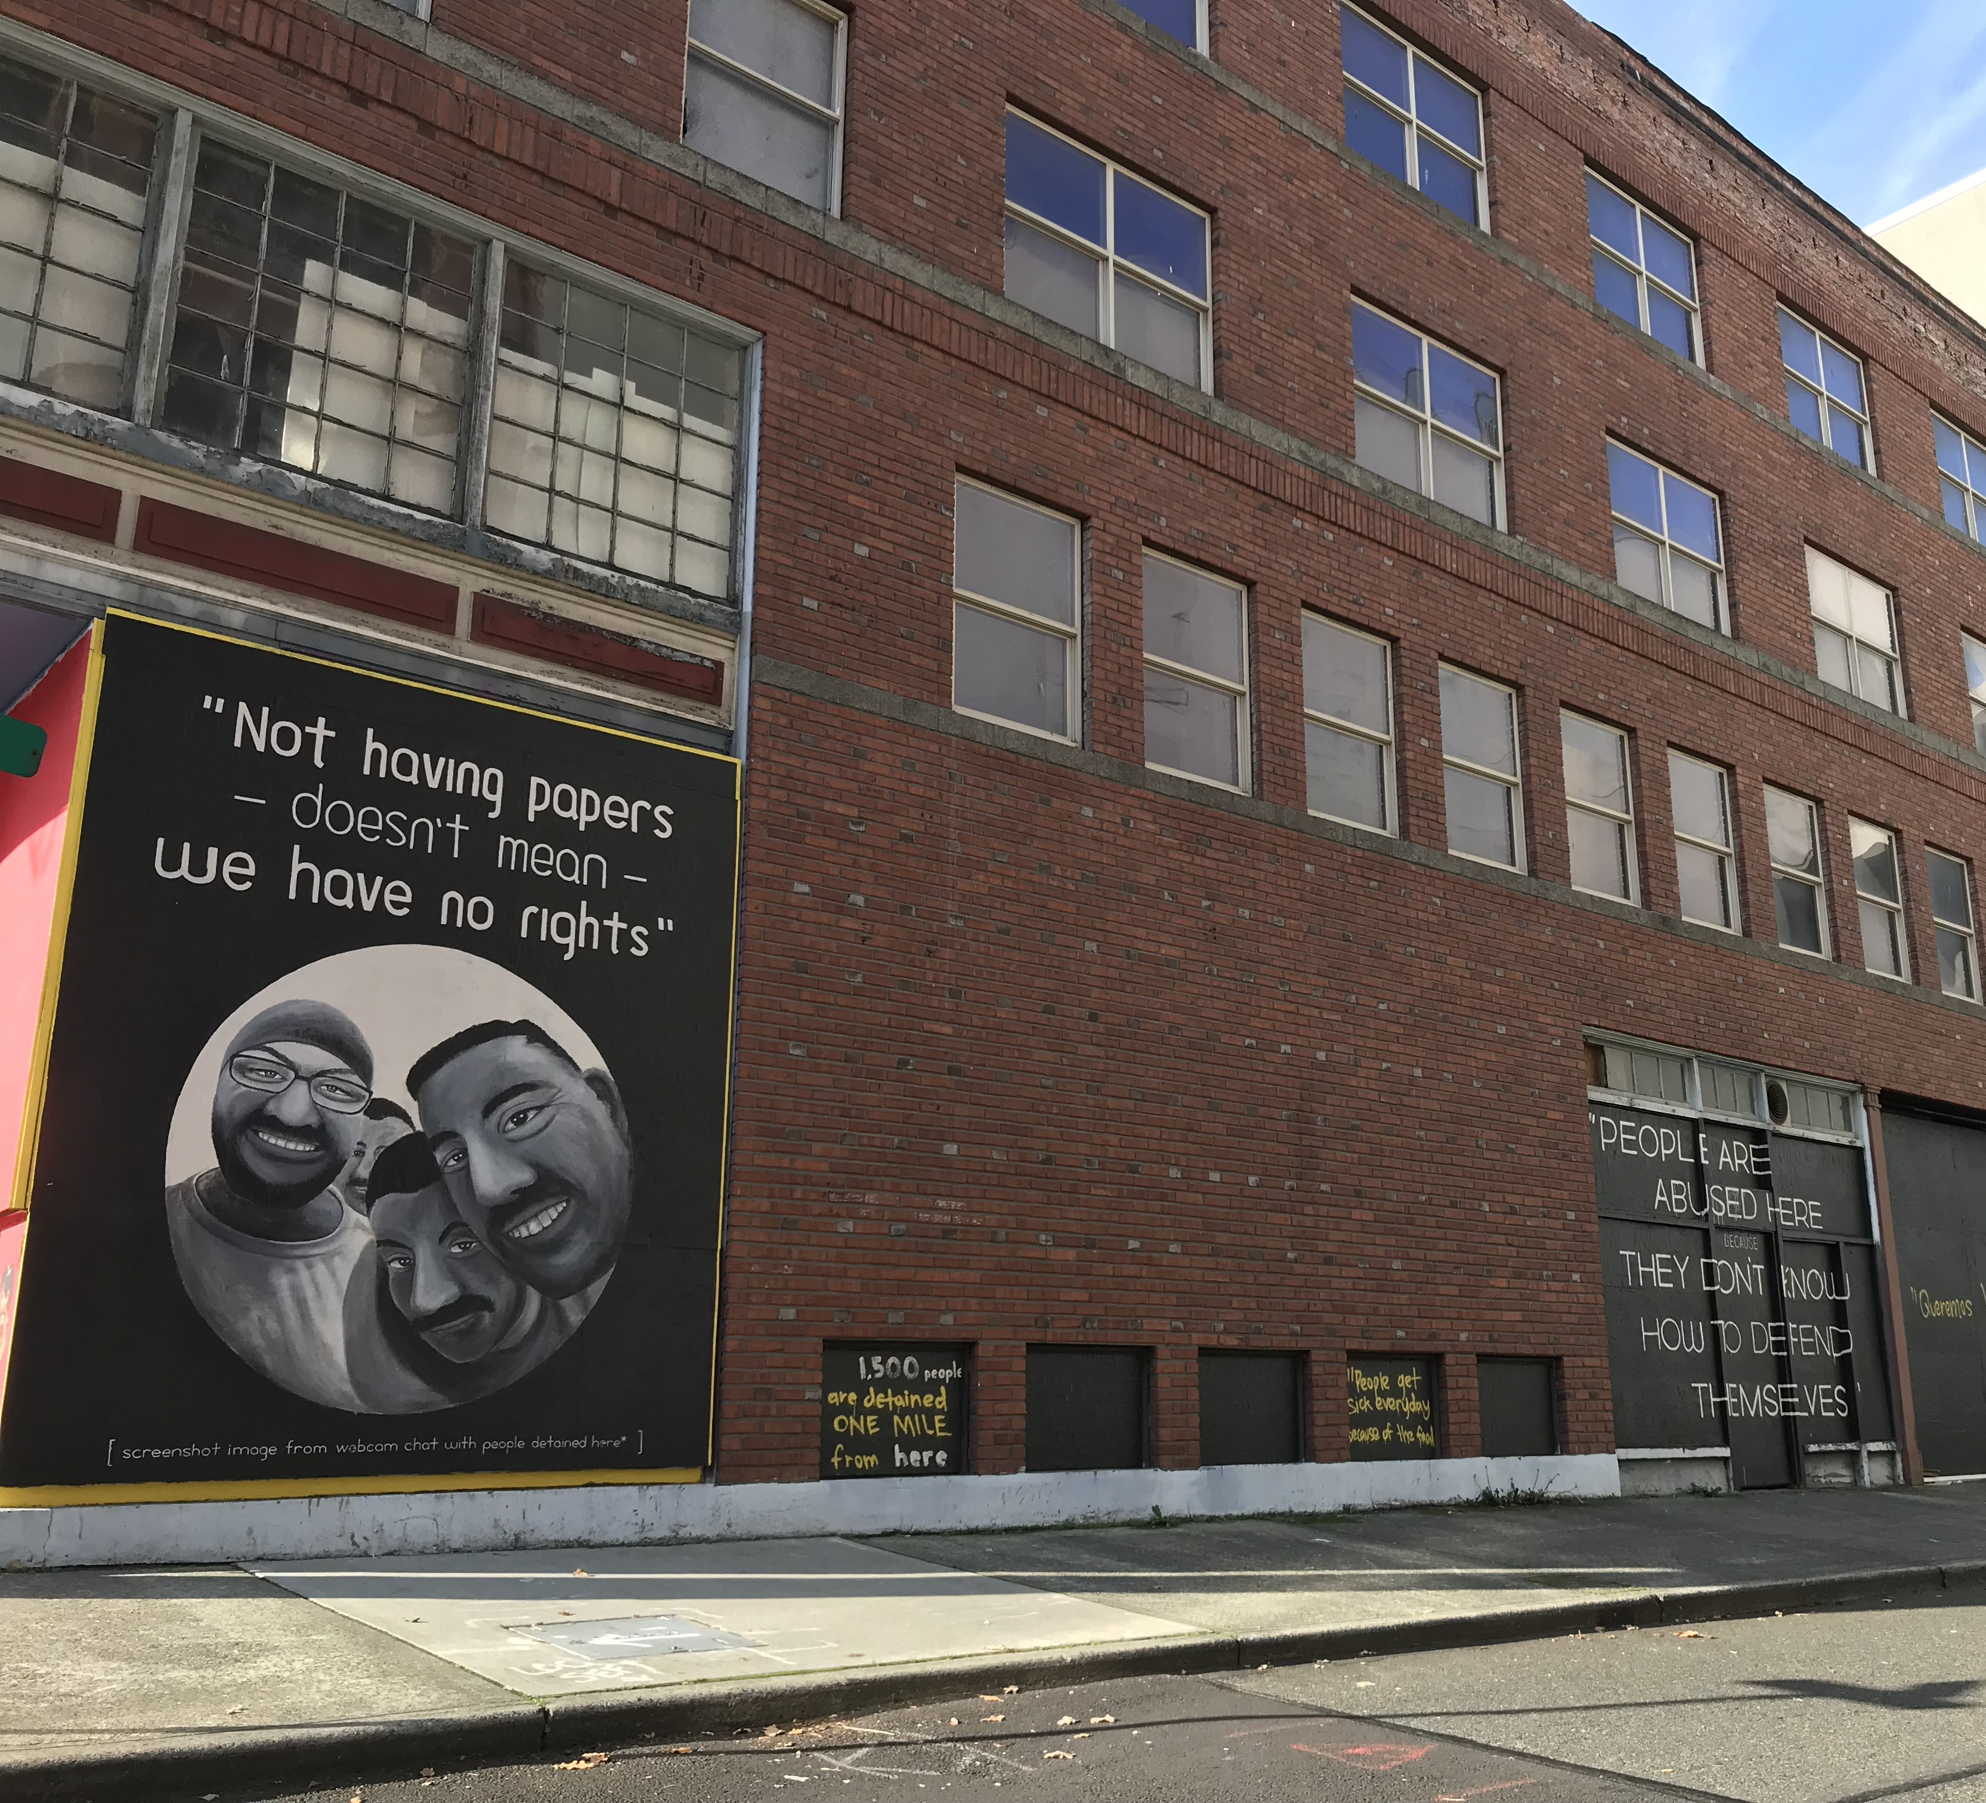
“Its complicated - there is a lot of political opinion. My political opinion is not necessarily reflective of most people in the United States. Although I think if they came to the detention center and saw who was in there and they fully understood what was going on, I suspect most people in the United States would be of the same opinion as me.”
-Clara, detention lawyer, Tacoma

Slide 11
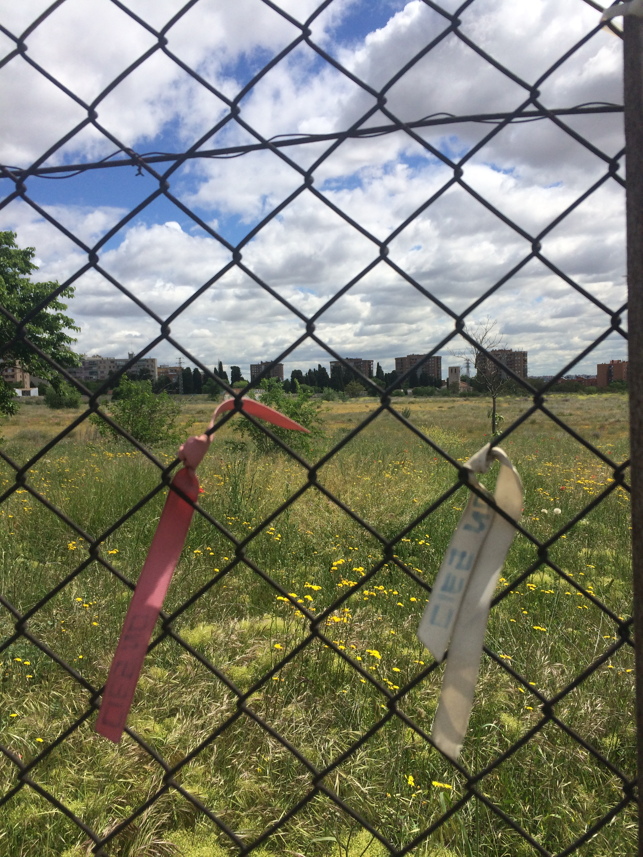
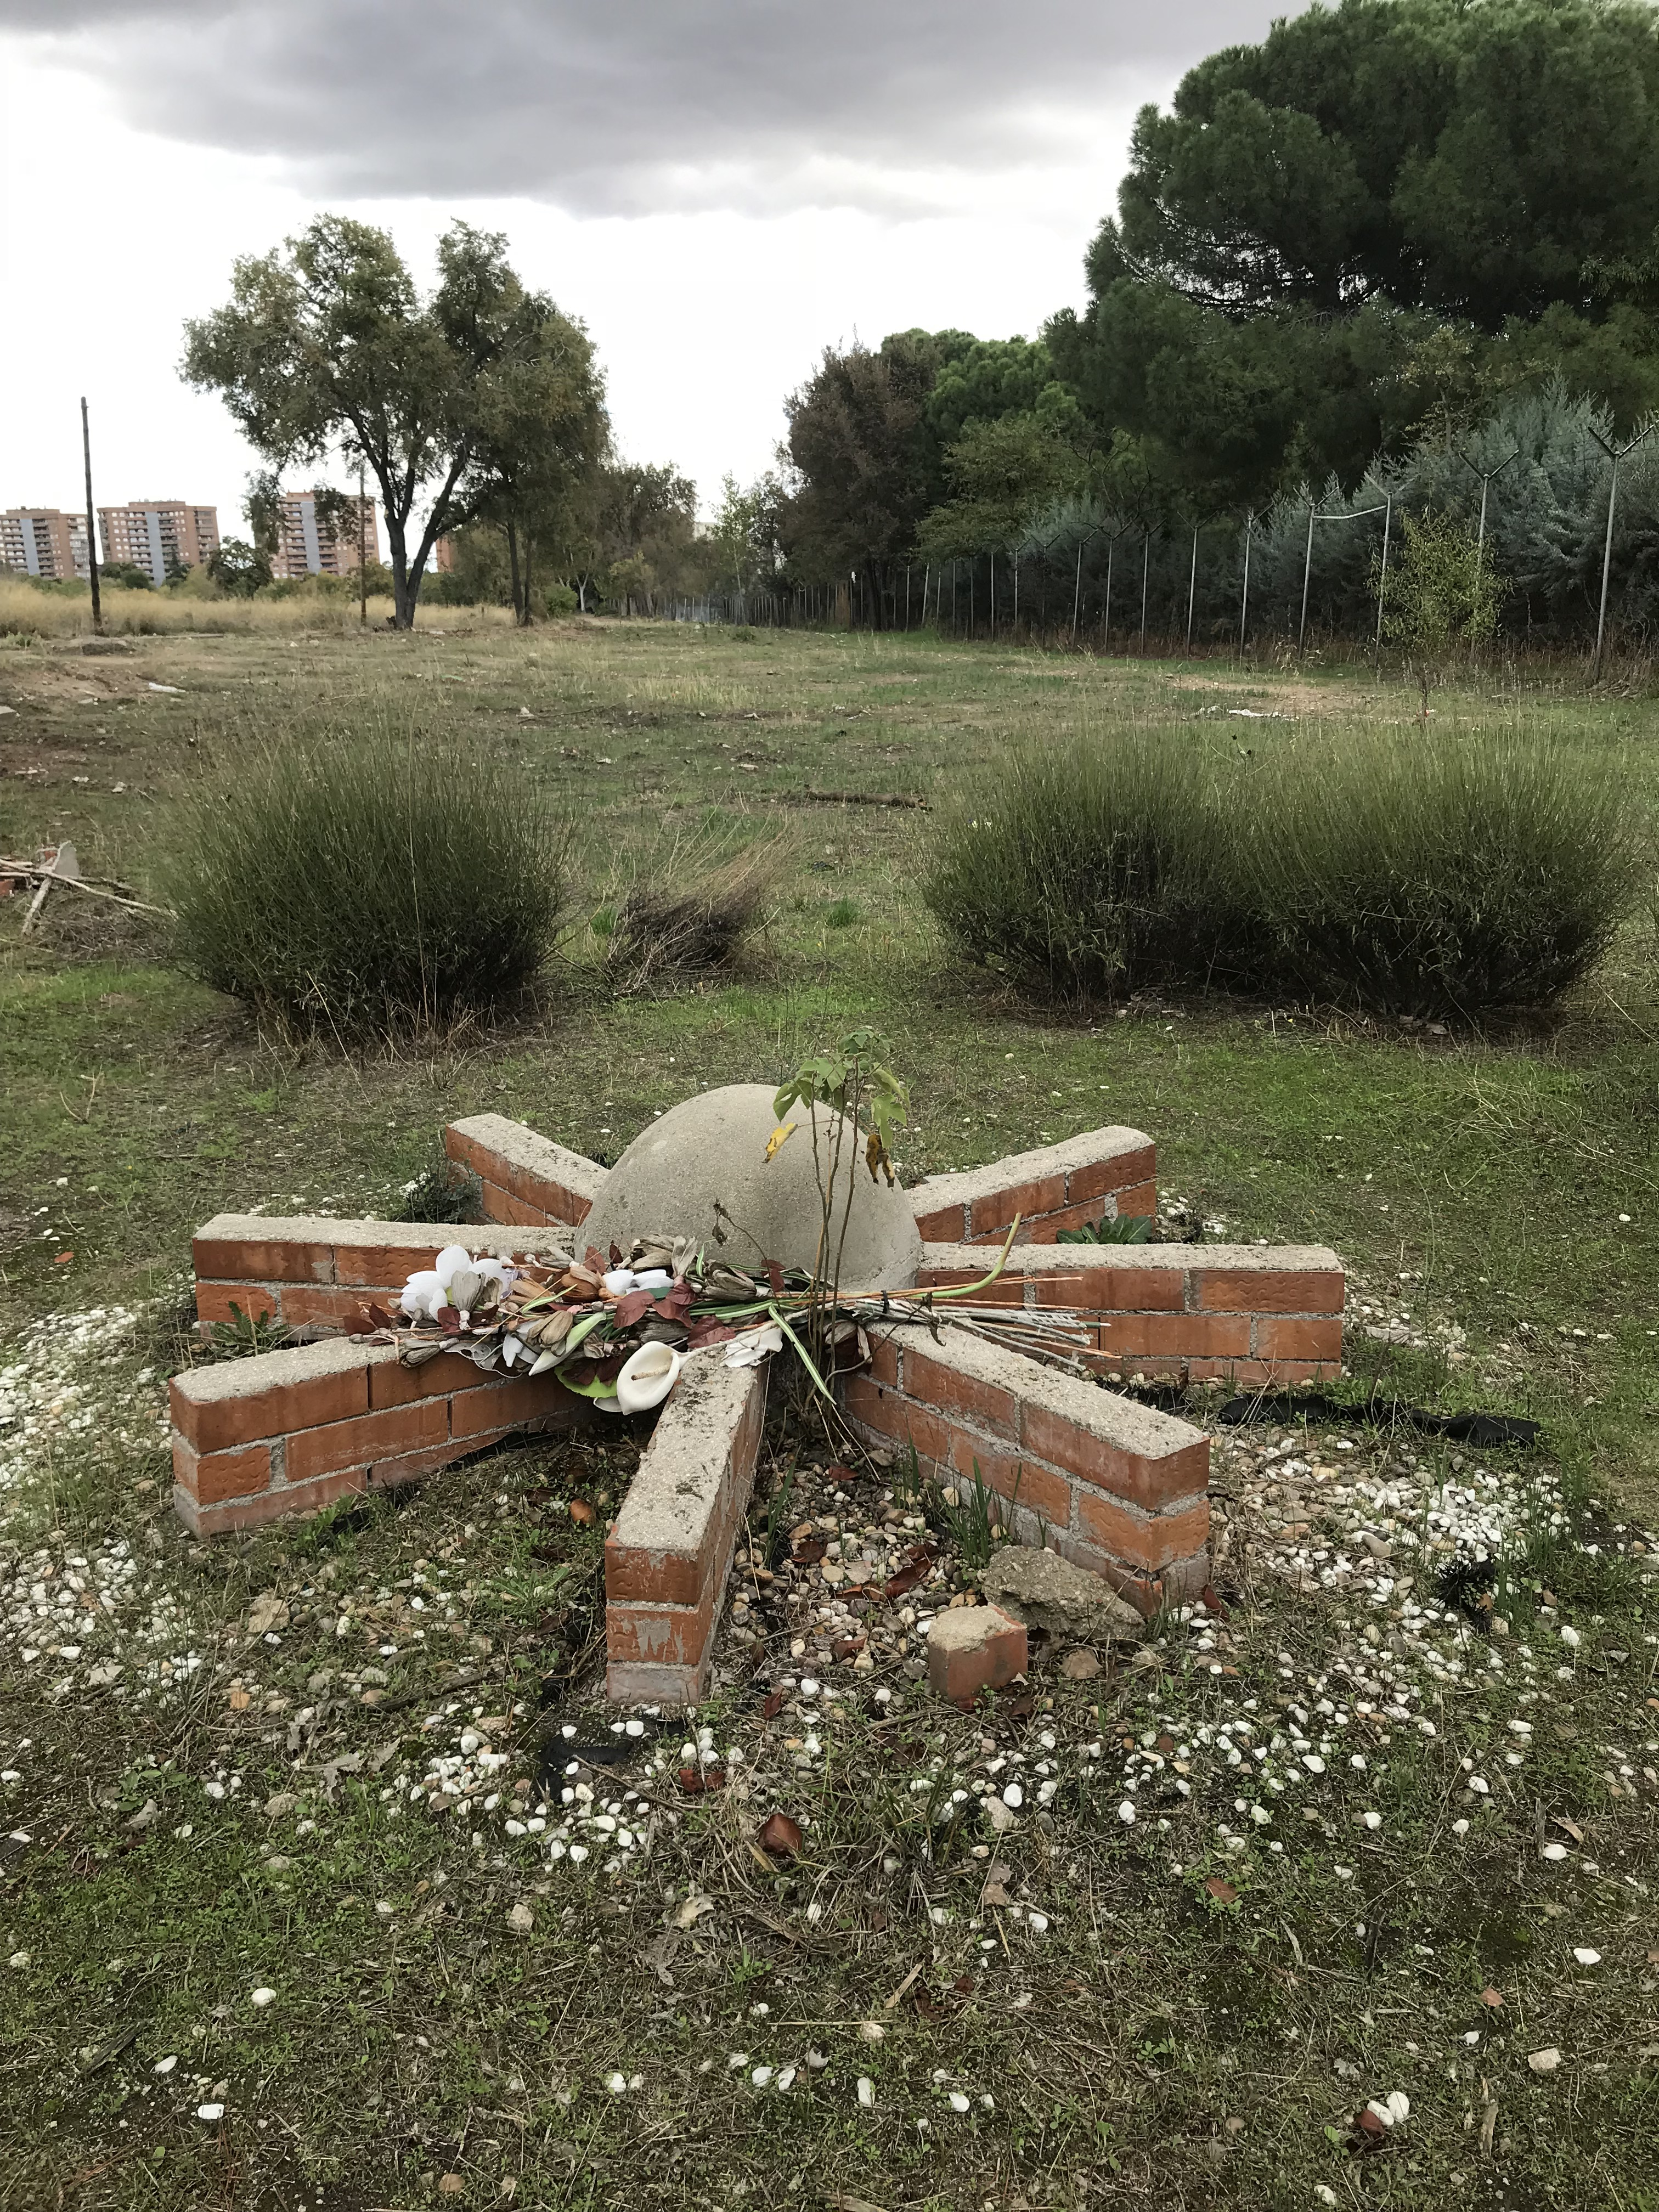

Slide 12
