Slide 1
Unexpected expectations
  Prison as a way to promote mobility
Christophe Mincke
(NICC - Université Saint-Louis)
December 17, 2018 - 3rd International Conference for Carceral Geography - University of Liverpool

Slide 2
  prison and legitimacy
the problematic justification of prison
the counterintuitive justification of prison
  rehabilitation in a disturbing place
  reinsertion through isolation
A labour of Sisyphus to legitimate prison
Belgian penitentiary law, a perspective on a new and legitimate prison

Slide 3
legitimation of immobilisation
depriving of physical mobility…
behind a wall…
and in a cell
time lost: the punishment doesn’t require any process to come about
painful immobilisation in a total institution, abolishing autonomy…
can be legitimate in society that praises anchorage and discipline…
and in a ‘mobilitarian’ society?

Slide 4
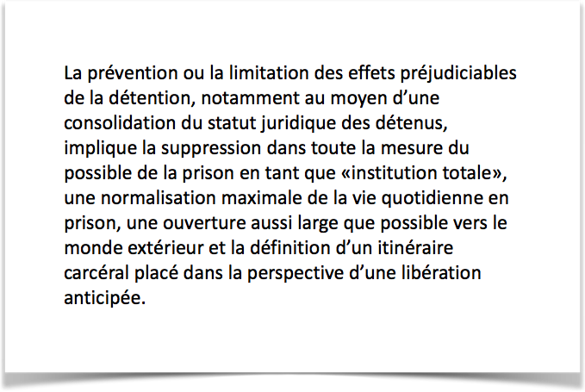
legitimation of immobilisation
depriving of physical mobility…
behind a wall…
and in a cell
time lost: the punishment doesn’t require any process to come about
painful immobilisation in a total institution, abolishing autonomy…
can be legitimate in society that praises anchorage and discipline…
and in a ‘mobilitarian’ society?

Slide 5
mobilitarian (ideal)?
representation of time as a flow and of space as a network…
change and movement are seen as irrepressible and…
mobility is an obligation…
in material and non-material spaces
4 imperatives:
  activity
  activation
  participation
  adaptation

Slide 6
a legitimate prison (in Belgium)?
general principles:
  limiting the harm
  normalisation
  respect and responsibility
  participation
what causes harm in a mobilitarian society? what is ‘normal’? what is respect if it is linked to responsability? participation? that’s already a mobilitarian imperative!

Slide 7
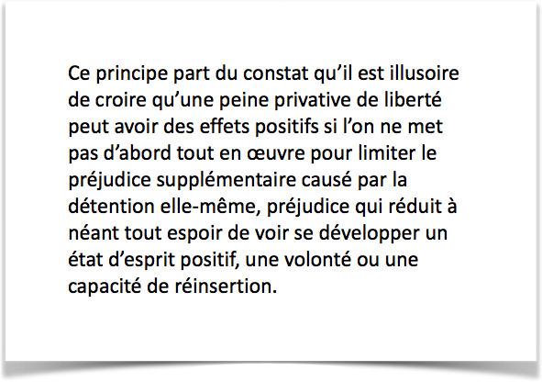
a legitimate prison (in Belgium)?
general principles:
  limiting the harm
  normalisation
  respect and responsibility
  participation
what causes harm in a mobilitarian society? what is ‘normal’? what is respect if it is linked to responsability? participation? that’s already a mobilitarian imperative!

Slide 8
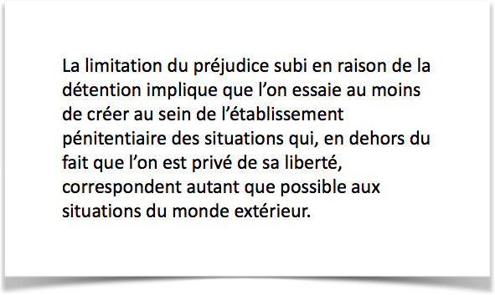
a legitimate prison (in Belgium)?
general principles:
  limiting the harm
  normalisation
  respect and responsibility
  participation
what causes harm in a mobilitarian society? what is ‘normal’? what is respect if it is linked to responsability? participation? that’s already a mobilitarian imperative!

Slide 9
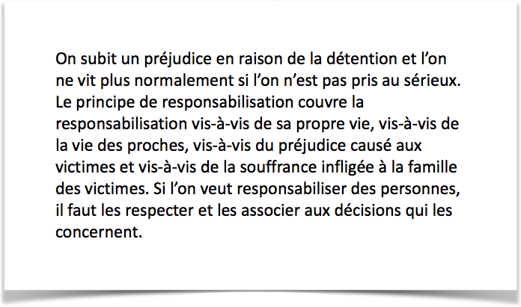
a legitimate prison (in Belgium)?
general principles:
  limiting the harm
  normalisation
  respect and responsibility
  participation
what causes harm in a mobilitarian society? what is ‘normal’? what is respect if it is linked to responsability? participation? that’s already a mobilitarian imperative!

Slide 10
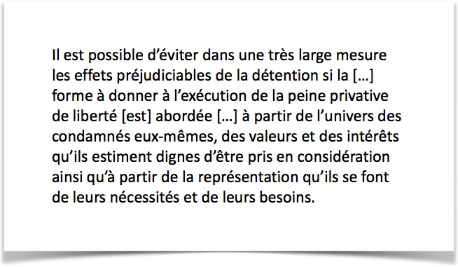
a legitimate prison (in Belgium)?
general principles:
  limiting the harm
  normalisation
  respect and responsibility
  participation
what causes harm in a mobilitarian society? what is ‘normal’? what is respect if it is linked to responsability? participation? that’s already a mobilitarian imperative!

Slide 11
from detention to transition
reducing the immobilisation of inmates
  limiting imprisonment to a mere deprivation of physical mobility
  compensating for physical immobility through an increased access to goods and services
  opening of the prison
presentation of the prison as the crossroad of trajectories, thus, as a transition in a mobility process
is that a real immobilisation?

Slide 12
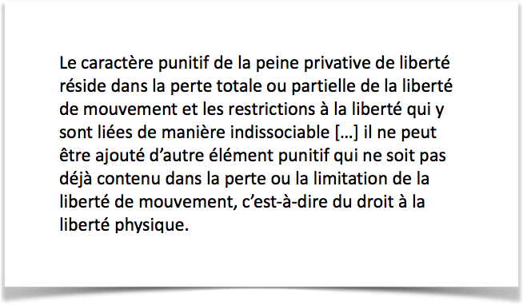
from detention to transition
reducing the immobilisation of inmates
  limiting imprisonment to a mere deprivation of physical mobility
  compensating for physical immobility through an increased access to goods and services
  opening of the prison
presentation of the prison as the crossroad of trajectories, thus, as a transition in a mobility process
is that a real immobilisation?

Slide 13
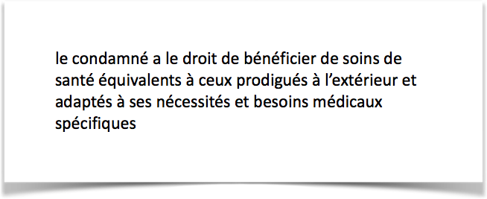
from detention to transition
reducing the immobilisation of inmates
  limiting imprisonment to a mere deprivation of physical mobility
  compensating for physical immobility through an increased access to goods and services
  opening of the prison
presentation of the prison as the crossroad of trajectories, thus, as a transition in a mobility process
is that a real immobilisation?

Slide 14
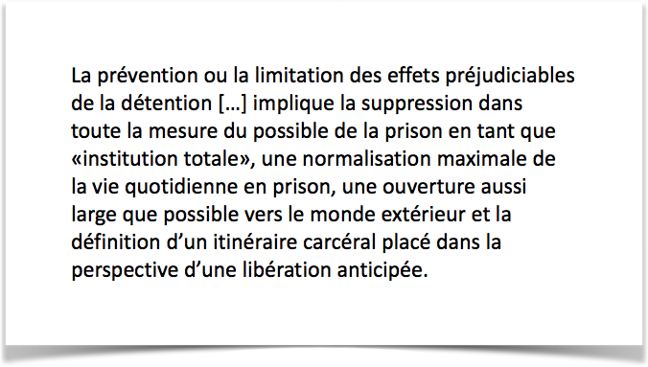
from detention to transition
reducing the immobilisation of inmates
  limiting imprisonment to a mere deprivation of physical mobility
  compensating for physical immobility through an increased access to goods and services
  opening of the prison
presentation of the prison as the crossroad of trajectories, thus, as a transition in a mobility process
is that a real immobilisation?

Slide 15
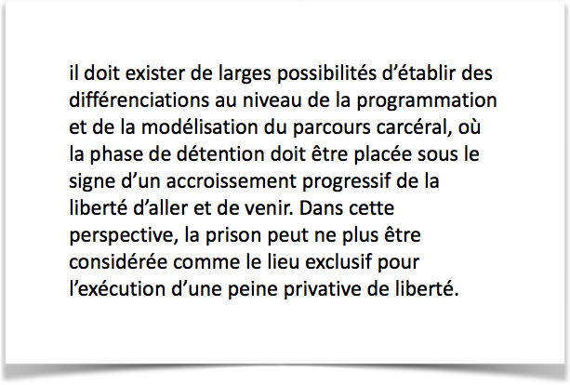
from detention to transition
reducing the immobilisation of inmates
  limiting imprisonment to a mere deprivation of physical mobility
  compensating for physical immobility through an increased access to goods and services
  opening of the prison
presentation of the prison as the crossroad of trajectories, thus, as a transition in a mobility process
is that a real immobilisation?

Slide 16
mobilising the inmates
the prison can no longer be a total institution
activity: prison time cannot be wasted
activation: offers are made, the inmate takes initiatives
participation: the prison (penalty) is a participatory project
adaptation: tailor-made and flexible penalties
the prisoner is no longer passive, waiting for the end of his time, he is a mobile individual… isn’t he free?

Slide 17
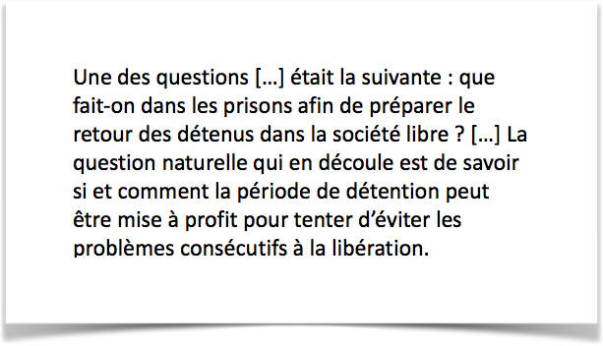
mobilising the inmates
the prison can no longer be a total institution
activity: prison time cannot be wasted
activation: offers are made, the inmate takes initiatives
participation: the prison (penalty) is a participatory project
adaptation: tailor-made and flexible penalties
the prisoner is no longer passive, waiting for the end of his time, he is a mobile individual… isn’t he free?

Slide 18
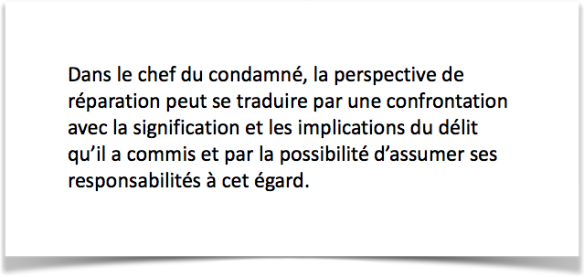
mobilising the inmates
the prison can no longer be a total institution
activity: prison time cannot be wasted
activation: offers are made, the inmate takes initiatives
participation: the prison (penalty) is a participatory project
adaptation: tailor-made and flexible penalties
the prisoner is no longer passive, waiting for the end of his time, he is a mobile individual… isn’t he free?

Slide 19
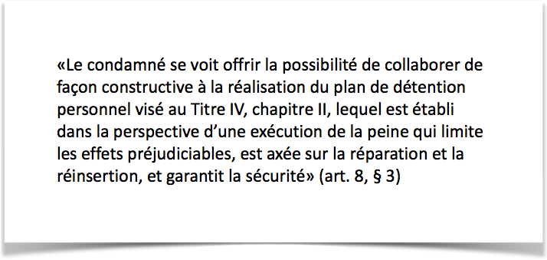
mobilising the inmates
the prison can no longer be a total institution
activity: prison time cannot be wasted
activation: offers are made, the inmate takes initiatives
participation: the prison (penalty) is a participatory project
adaptation: tailor-made and flexible penalties
the prisoner is no longer passive, waiting for the end of his time, he is a mobile individual… isn’t he free?

Slide 20
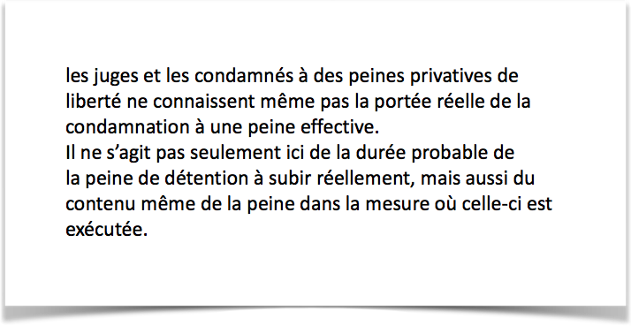
mobilising the inmates
the prison can no longer be a total institution
activity: prison time cannot be wasted
activation: offers are made, the inmate takes initiatives
participation: the prison (penalty) is a participatory project
adaptation: tailor-made and flexible penalties
the prisoner is no longer passive, waiting for the end of his time, he is a mobile individual… isn’t he free?

Slide 21
the symbolic abolition of prison
in a society praising mobility…
but without any intention to abolish prison…
one solution can be a symbolic abolition
proclaiming the restriction to physical immobility
considering prison as a crossroad and…
urging the detainees to conform to a mobilitarian ideal
prison is no longer a scandal if it become a mobility-promotor

Slide 22


Christophe Mincke
christophe@mincke.be
Recording of the presentation on
www.mincke.be

