Slide 1
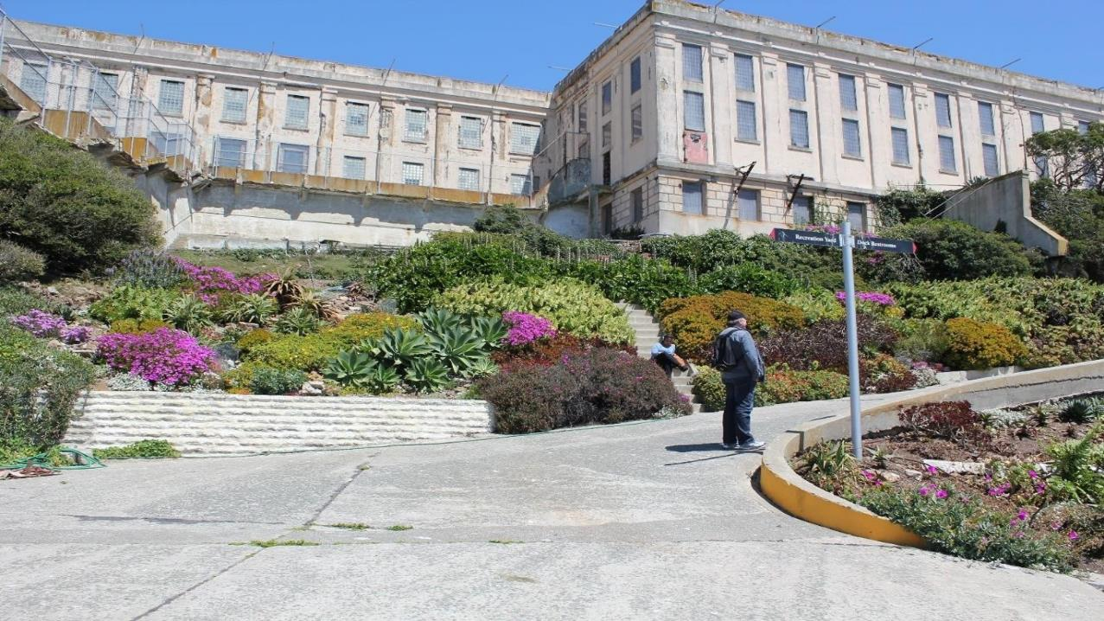
Tending the prison garden: following plants and plant knowledge in and out of prisons
Elizabeth Lara, PhD candidate
Supervisors A/Prof. Eben Kirksey and Dr Bree Carlton
Anthropology, Deakin University, Melbourne

Slide 3
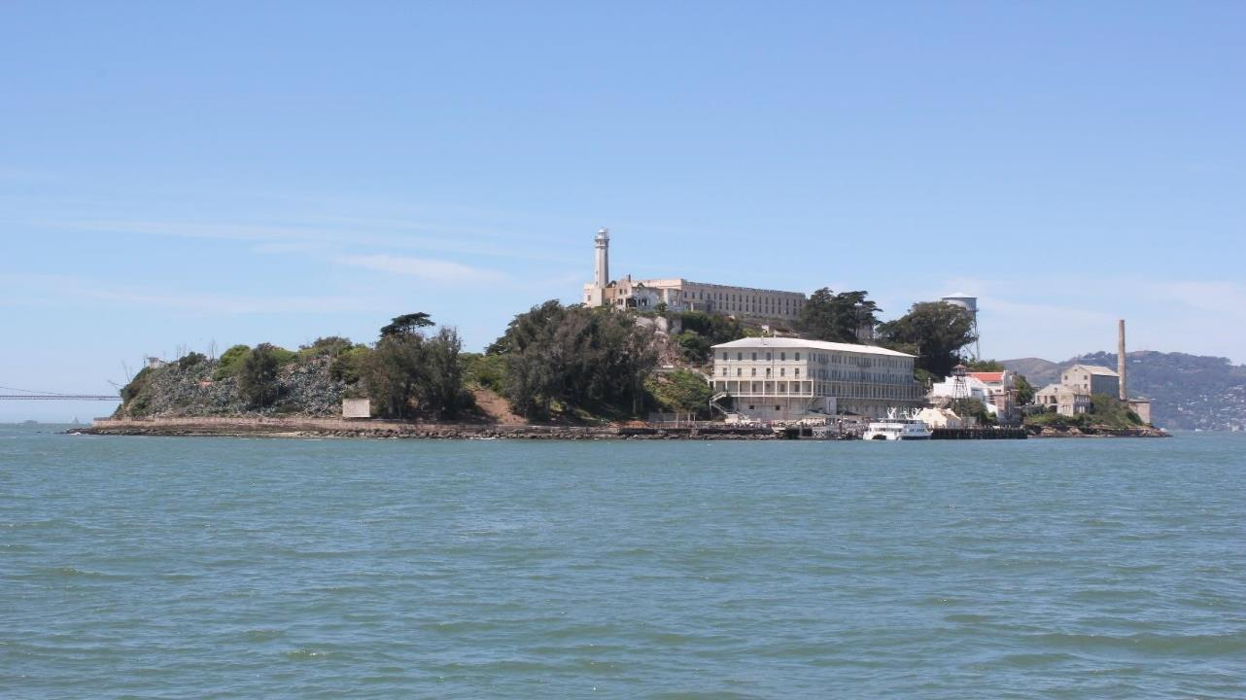
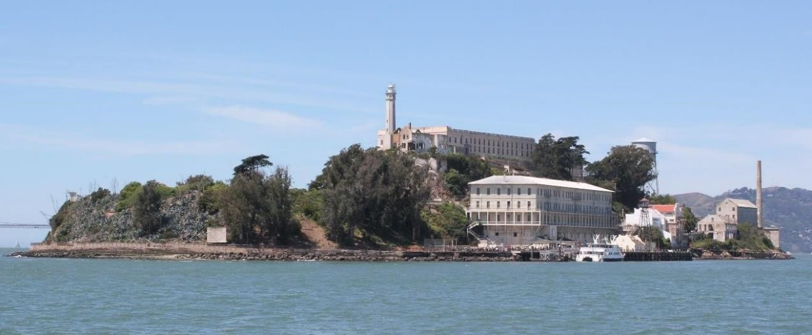

Slide 4
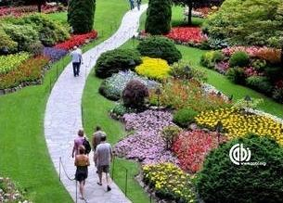

Benfield, R. W. (2013). Garden Tourism (Revised ed. edition). Boston: CABI.

Slide 5
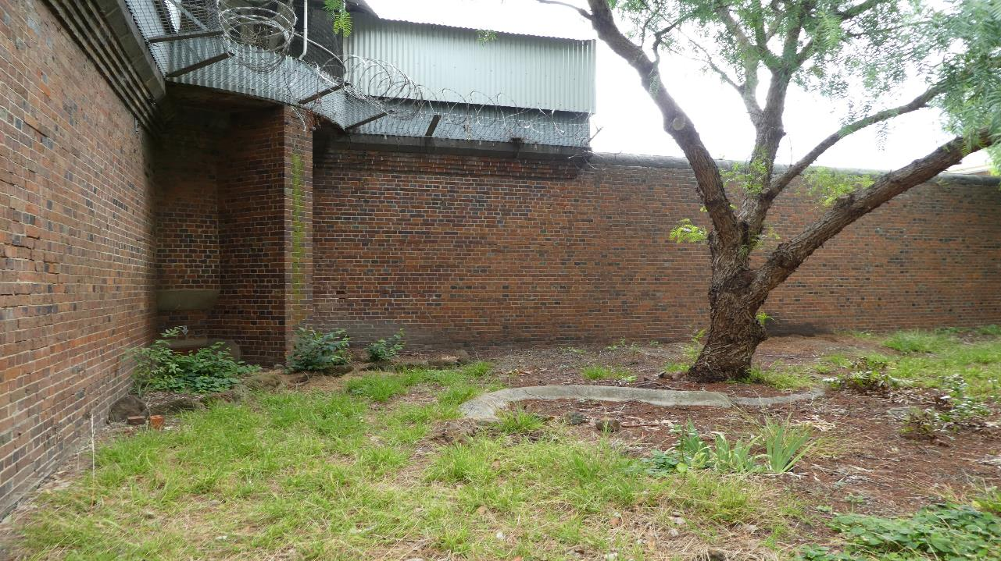
Carceral-horticultural interfaces
Gibson and Ellis, “Human and plant interfaces: relationality, knowledge and practices,” 2018
“…plants are situated in a network of ecologies, sites, practitioners, philosophies and practices of knowledge making.”
“A range of effects and affects emanate from the vegetal world: many of them are misrecognised, unacknowledged or simply explained away as mere metaphor.” (76)

Slide 6
Carceral-horticultural interfaces
Prison gardens
Post-release gardens
Prison museum gardens
Garden-art projects with carcerality as their subject
Solitary Gardens, Les Fleurs Maudites

Slide 7
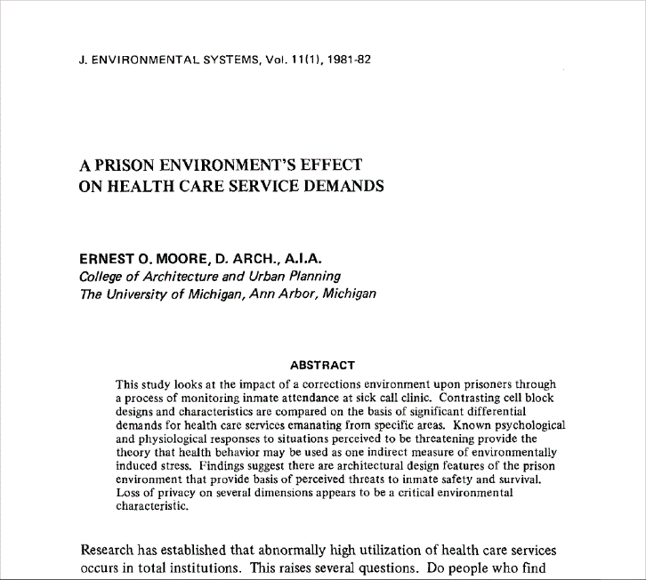
Moore, E. O. (1981). A prison environment’s effect on health care service demands. Journal of Environmental Systems, 11, 17–34.

Slide 8
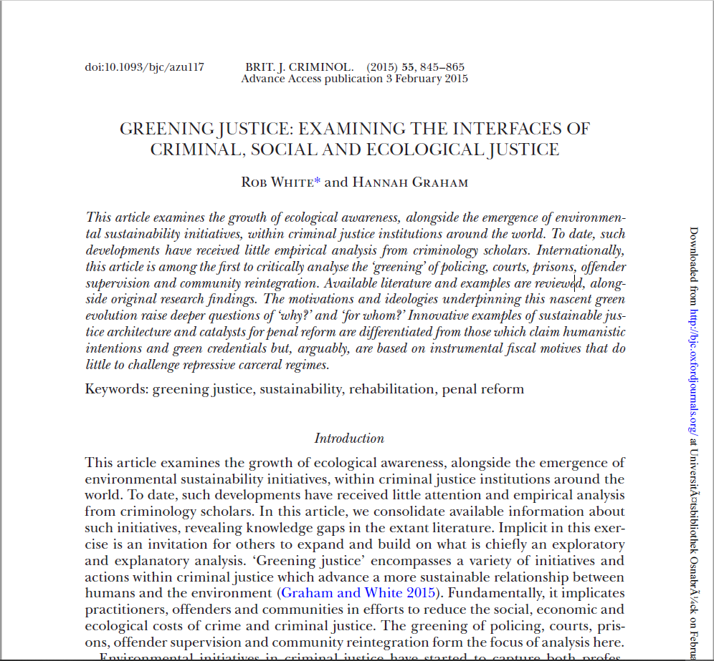
Moore, E. O. (1981). A prison environment’s effect on health care service demands. Journal of Environmental Systems, 11, 17–34.

Slide 9
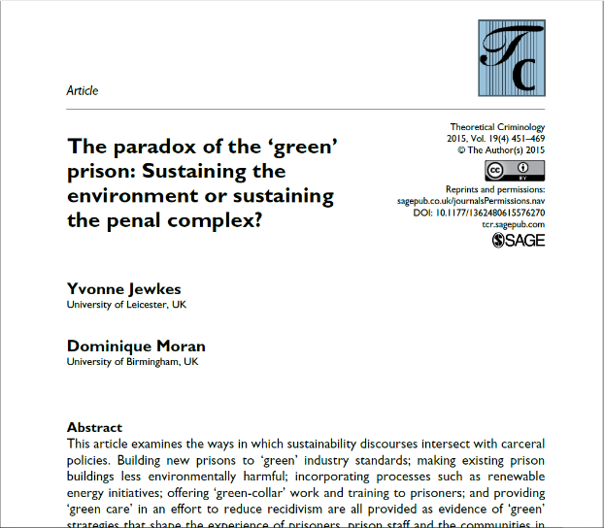
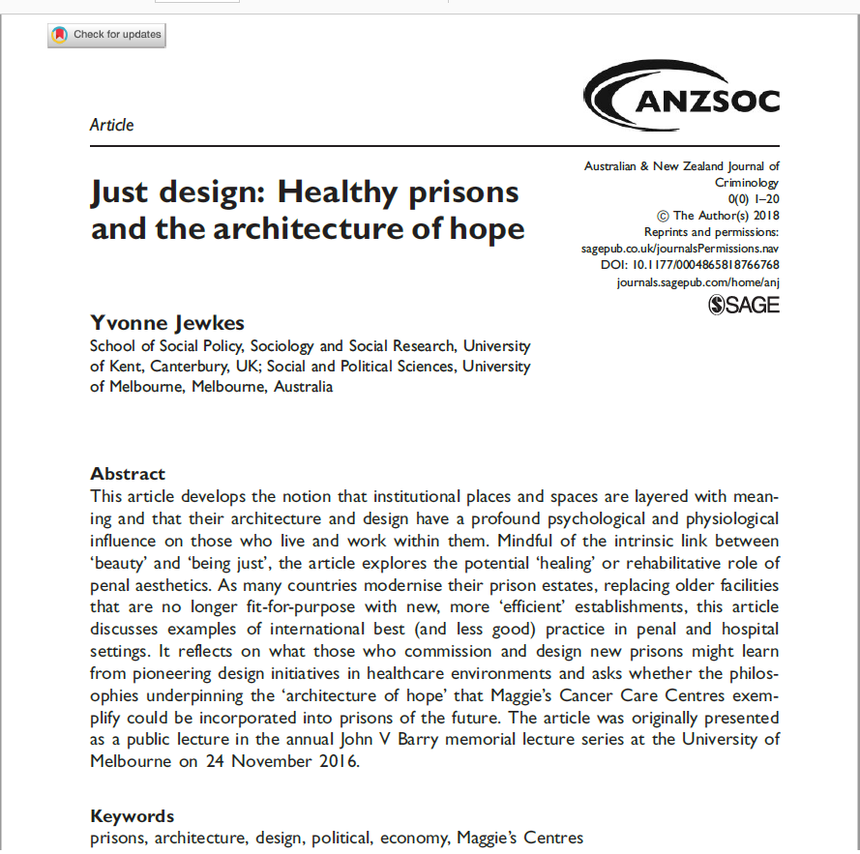
Jewkes, Y., & Moran, D. (2015). The paradox of the ‘green’ prison: Sustaining the environment or sustaining the penal complex? Theoretical Criminology, 19(4), 451–469.
Jewkes, Y. (2018). Just design: Healthy prisons and the architecture of hope. Australian & New Zealand Journal of Criminology, 51(3), 319–338.

Slide 10
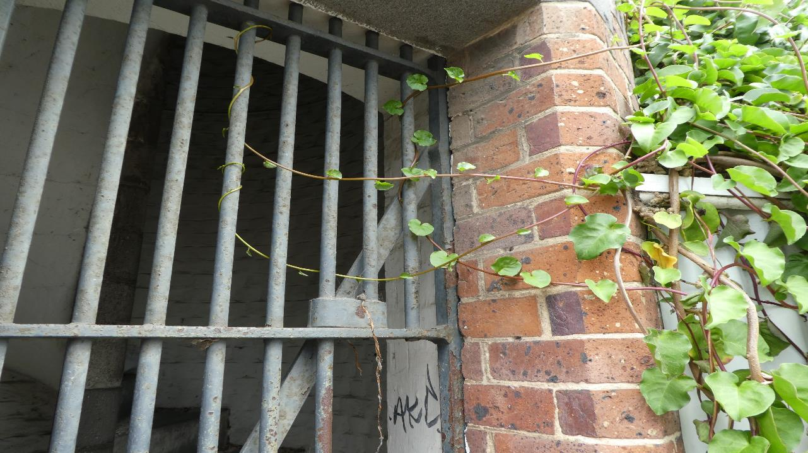
How are prison gardens and post-release gardens are being imagined, understood, and brought into being?
What flows of knowledge, lifeforms, and materials are involved in the realization, maintenance, and production plans of prison gardens and post-release gardens?

Slide 11
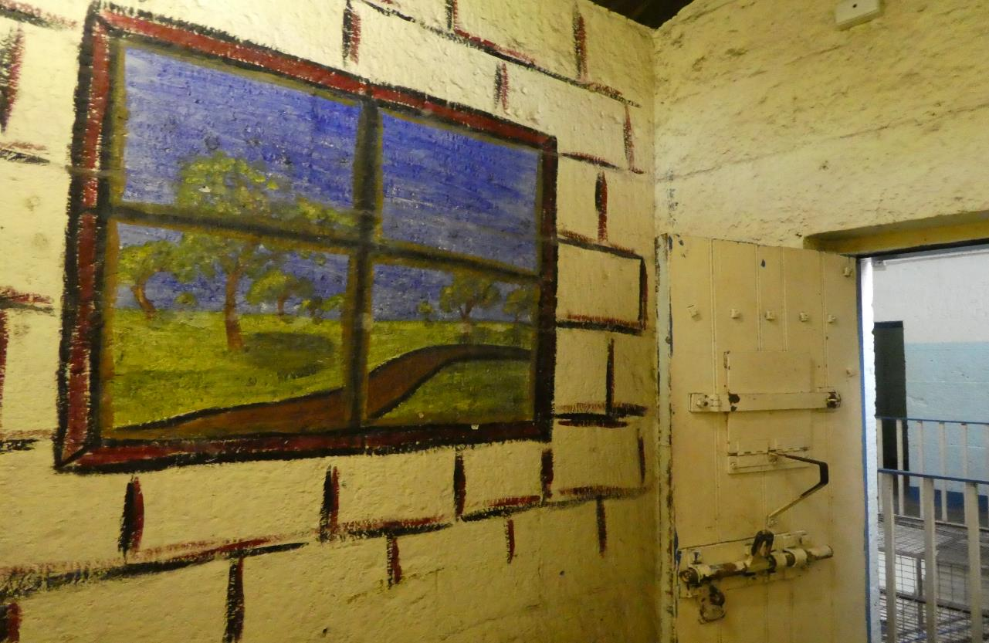
Norms and objectives
Concerns, interests and experiences
Words and behaviors
Knowledge of plants and gardens
Living and non-living material

Slide 12
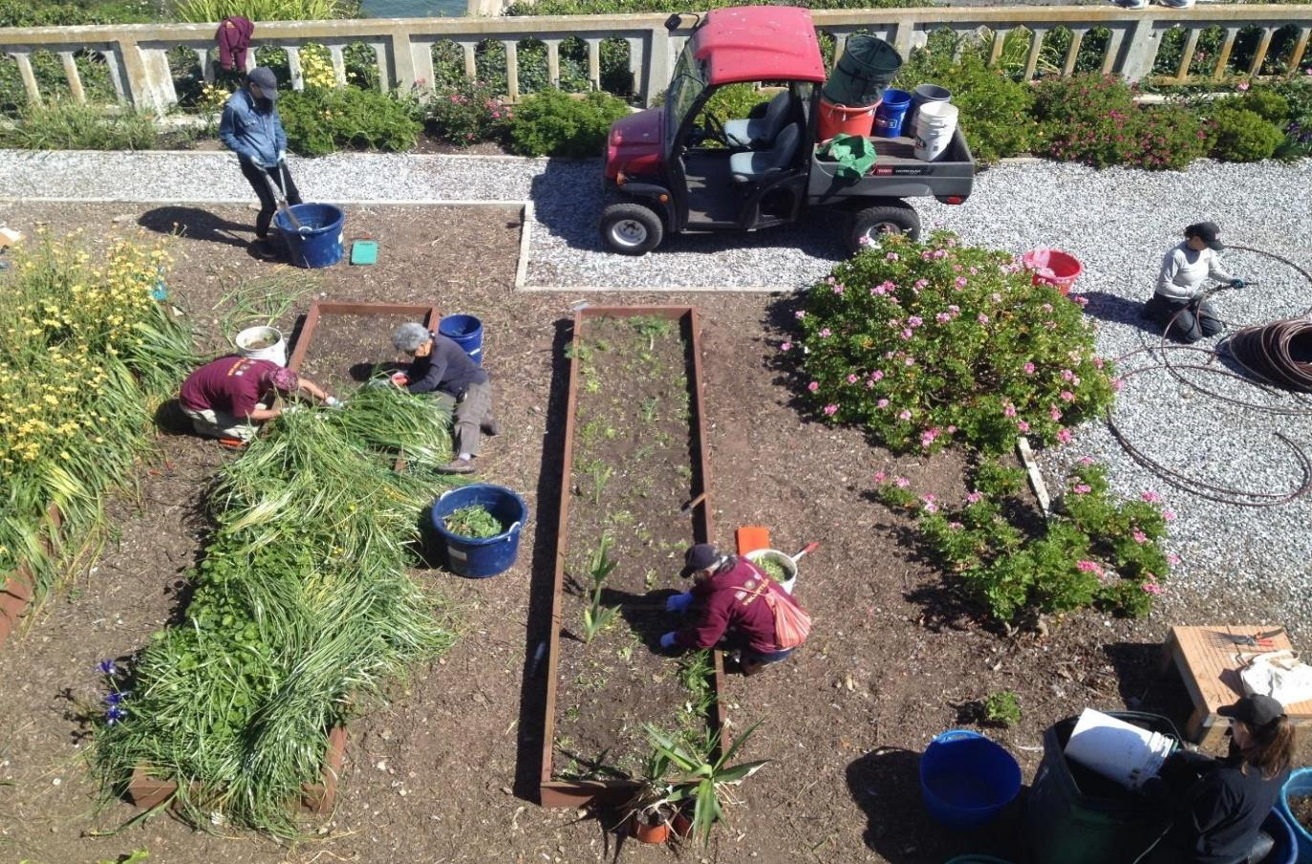
Framing the prison garden

Slide 13
Framing the prison garden
Deleuze and Guattari, On the Line, 1983
Fundamentally relational
Deterritorialization, Reterritorialization, the Rhizome, and Becoming
“The orchid is deterritorialized by forming an image, an exact tracing of the wasp; but the wasp reterritorializes itself onto this image. The wasp is deterritorialized, however, by becoming part of the orchid’s reproductive apparatus, but it reterritorializes the orchid by transporting its pollen. […]” Here we see “the becoming-orchid of the wasp, the becoming-wasp of the orchid – […] the two becomings intertwining and relaying each other in a circulation of intensities that always pushed the deterritorialization further along.” (19-20)

Slide 14
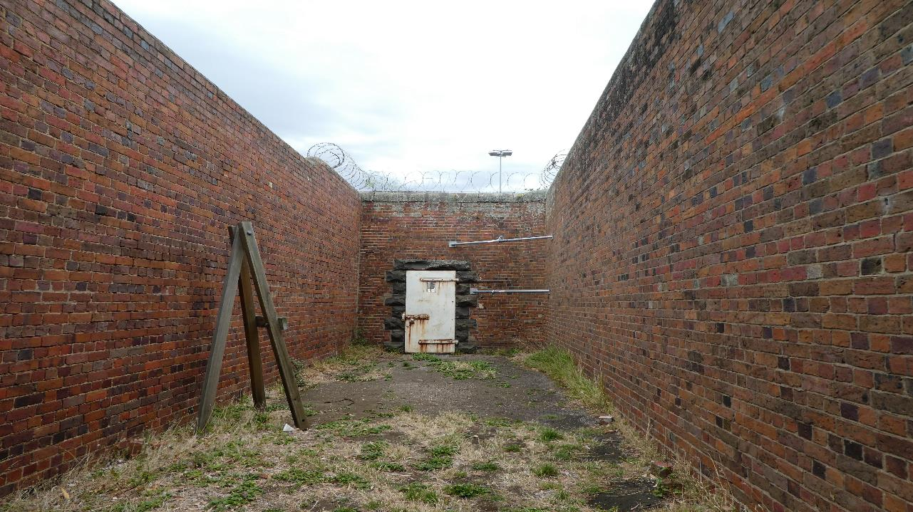
Framing the prison garden
Haraway, Staying with the Trouble, 2016
“We live in […] troubling and turbid times. The task is to become capable, with each other in all of our bumptious kinds, of response.[…] The task is to make kin in lines of inventive connection as a practice of learning to live and die well with each other in a thick present. Our task is to make trouble, to stir up potent response to devastating events, as well as to settle troubled waters and rebuild quiet places. […] In fact, staying with the trouble requires learning to be truly present, not as a vanishing pivot between awful or edenic pasts and apocalyptic or salvific futures, but as mortal critters entwined in myriad unfinished configurations of places, times, matters, meanings.” (1)
A position beyond “a comic faith in technofixes” or “a position that the game is over” (3)

Slide 15
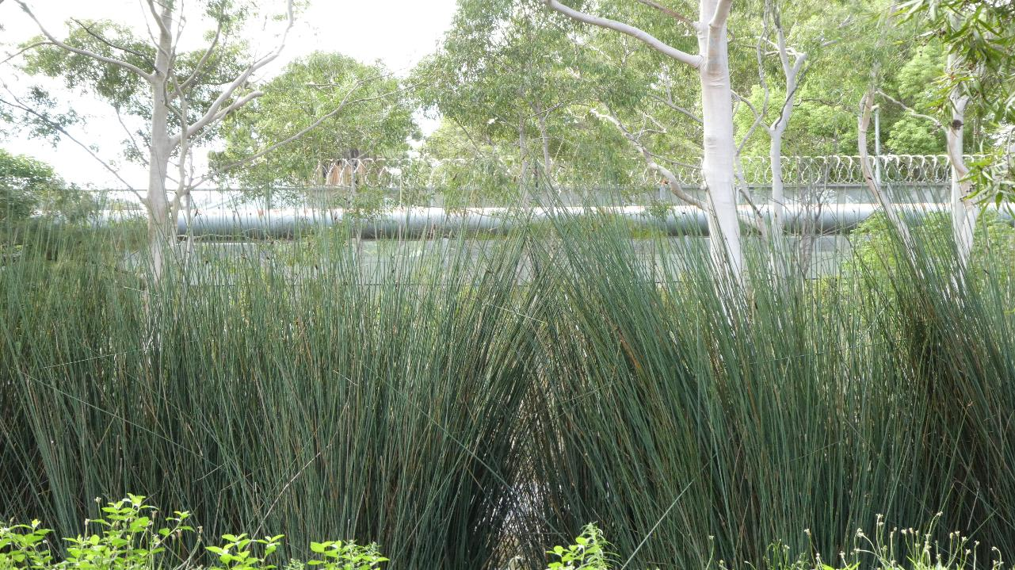
Framing the prison garden
Tsing et al., Arts of Living on a Damaged Planet, 2017
Prisons as landscapes in ruin and as producing ruination
“How can we best use our research to stem the tide of ruination?” (1)
“…we approach this problem by showing readers how to pay better attention to overlaid arrangements of human and nonhuman living spaces, which we call “landscapes.” (1)
“We must wander through landscapes, where assemblages of the dead gather together with the living. In their juxtapositions, we see livability anew.” (5)

Slide 16
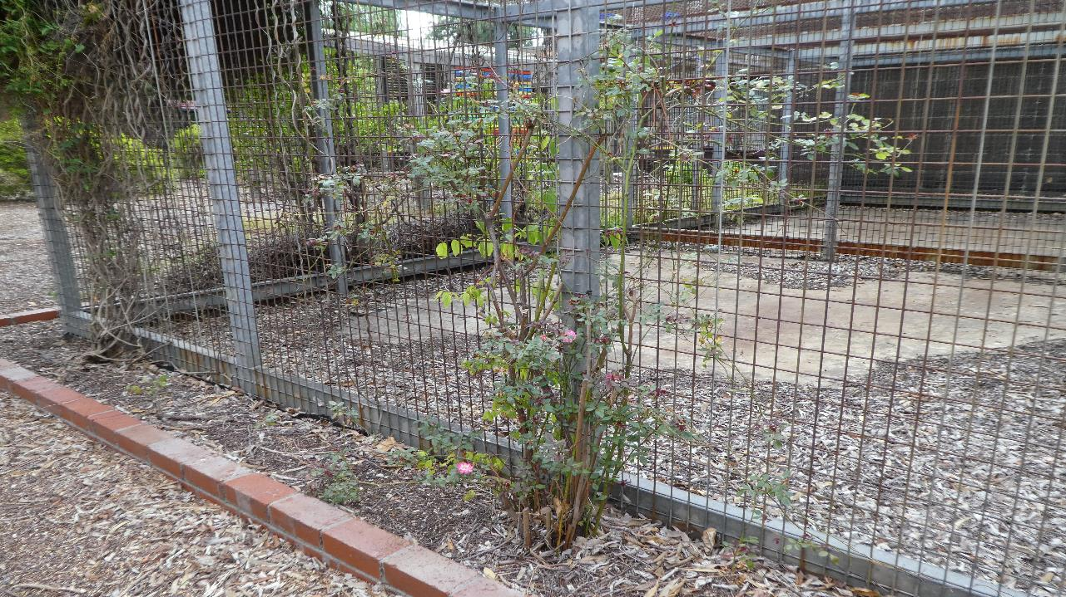
Framing the prison garden
Gagliano et al., The Language of Plants: Science, Philosophy, Literature, 2017
Critical plant studies
An emerging field which offers “a broad framework for reevaluating plants, their representations, and human-plant interactions” and involves the synthesis of “principles of ethics, aesthetics, poetics, agency, cognition, intentionality, communication, and language” (xvi).

Slide 17
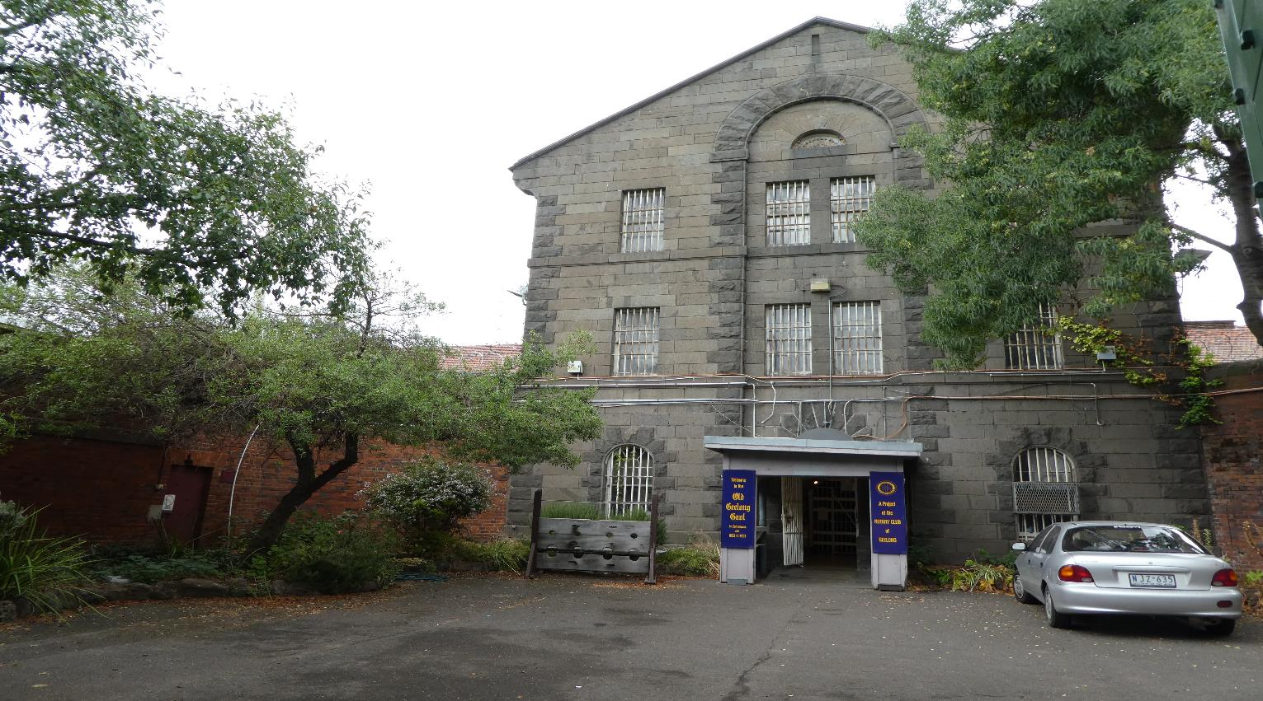
(
Multispecies ethnography (Kirksey and Helmreich 2010)
synthesize bodies of knowledge, field approaches, creative practices, and processes of analysis that are directly concerned with the lives and deaths of various organisms
do the collaborative, political, ethical, environmental work of decentering the human through the questions we ask, the tools we use, and the stories we tell (Swanson 2017, 95)

Slide 18
(
Multispecies ethnography (Kirksey and Helmreich 2010)
Using the stuff of the garden to elicit data about plants, knowledge of plants, and plant practices (Gibson 2018)
Becoming a gardener alongside other gardeners

Slide 19
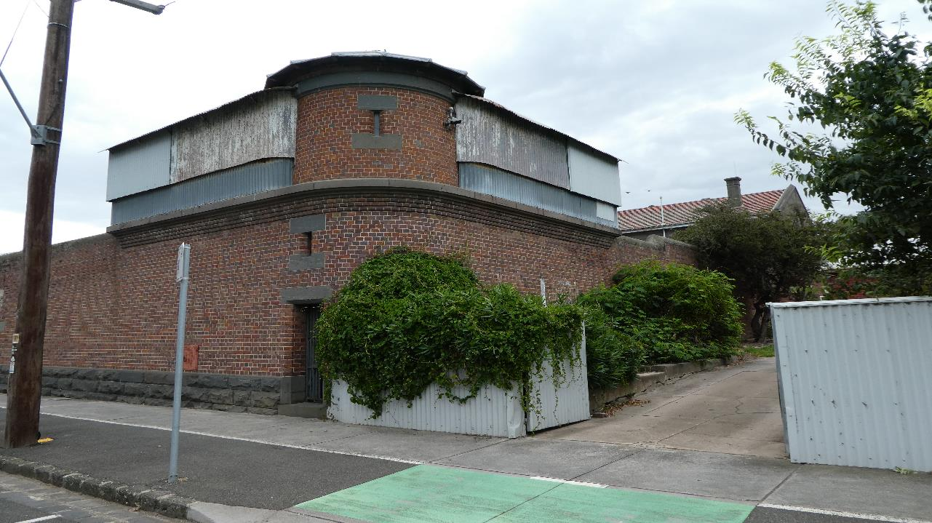
Challenges
Using the typically disparate fields of carceral studies and multispecies studies to learn more about the strengths and weaknesses of each
The non-human?

Slide 20
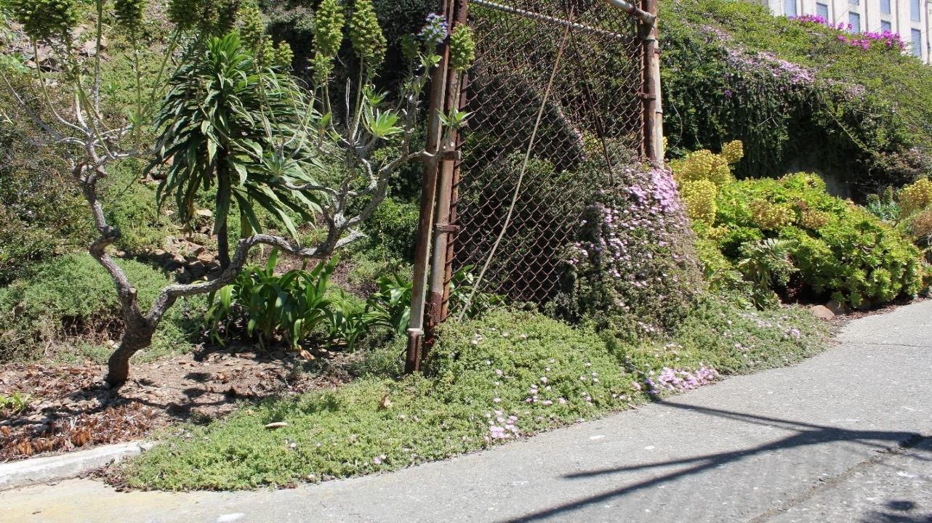


Slide 21
Thank you!
elara@deakin.edu.au

