Slide 1
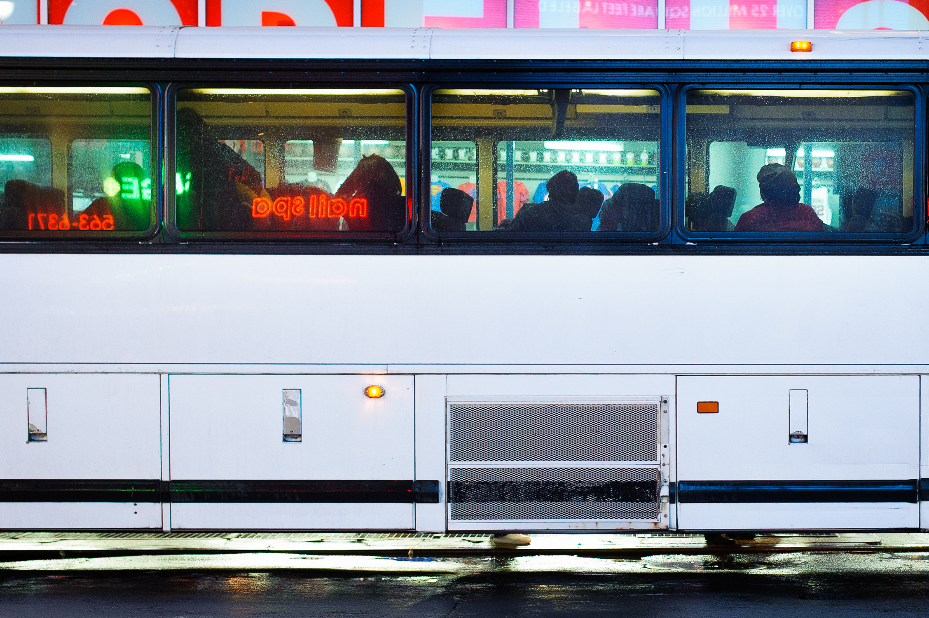
Coerced Mobilities and (Dis)location
The Workings of Prison Transfers in the United States
Iolanthe Brooks, Clark University
International Carceral Geographies Conference
12/17/2018

Slide 2
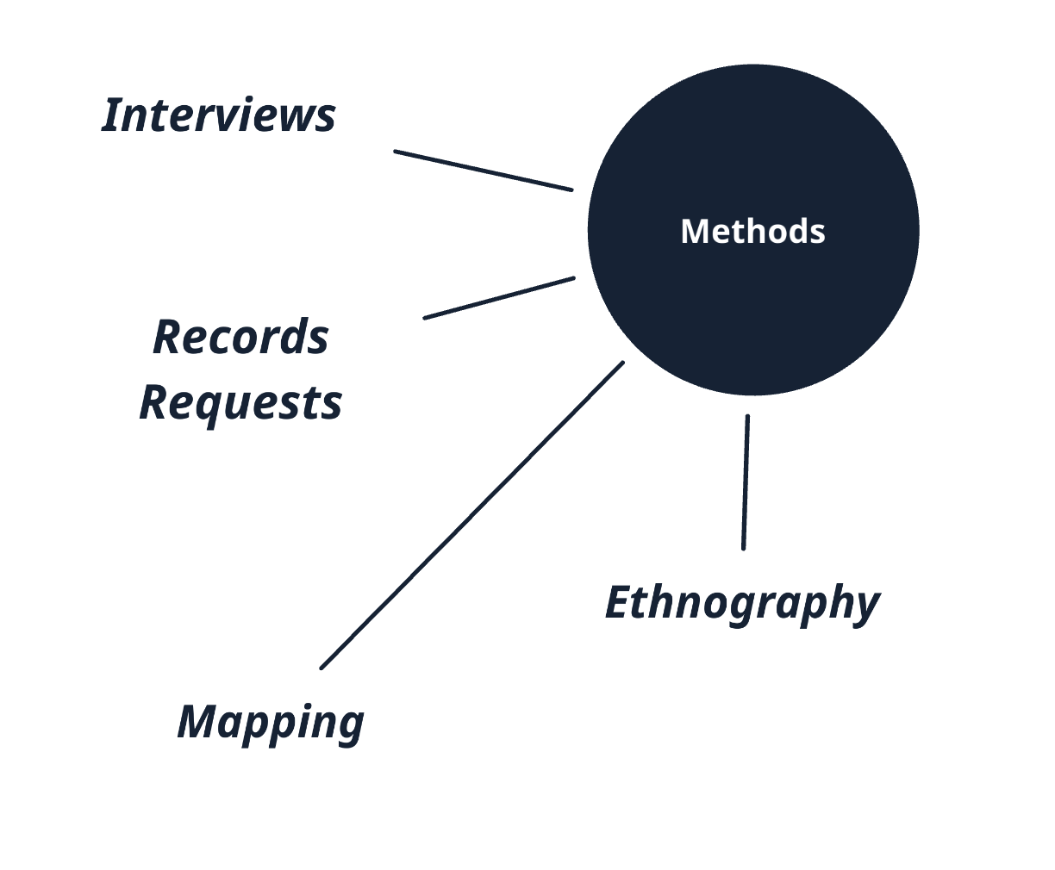
How do transfers constitute and complicate the carceral?
How do they work upon people enmeshed in the vast carceral system and how do those people negotiate and resist them?

Slide 3
Transfers: Logistics & Temporality
Photo Credit: Jacobia Dahm, In Transit (2014)
Notes:
Transfers are mundane
The mundanity of transfers is exactly what make them central to understanding the system. This chapter considers this nitty-gritty of transfers: what they actually are, how many of them happen, who receives them, and why. Sitting in the midst of the logistics of transfers, supposedly apolitical and unimportant, it will contend that none of these traits are inevitable. Instead, the transfer system can be understood through research on critical logistics and circuits of capital, highlighting the politicization of flows of people and the ways those flows reflect broader flows of capital.
In short, this paper will ask why and how people get on the many buses that route their journeys within the carceral system through prison transfers.

Slide 4
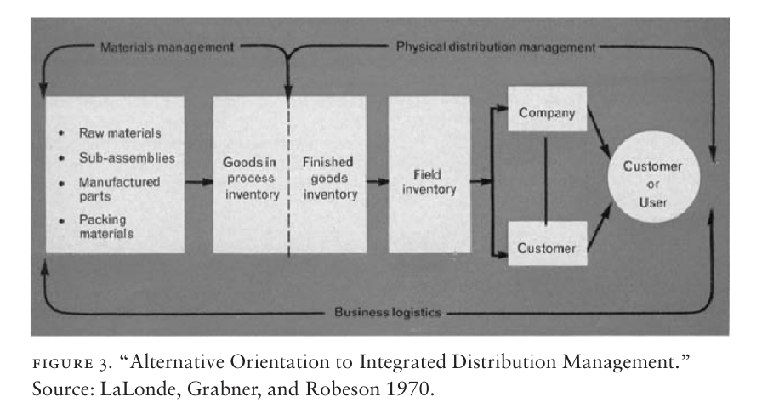
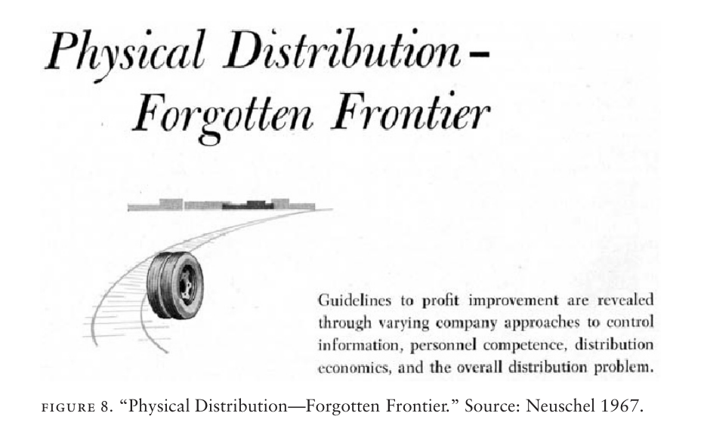
Logistics – the management and calibration of time and space in order to move goods from producers to consumers.

Slide 5
Photo Credit: Cowen (2014)

Slide 6
Logistics help us to see:
- Prisons as networked
- Transfers as political, attempting to produce un-human subjects
- Transfers as temporal punishment
Photo credit: WNYC

Slide 7
Frequent & Networked
In 1 day, Mississippi moved 84 people a total of ~12,000 miles.
In 1 week, Mississippi moved 293 people a total of ~36,500 miles.
In 1 year, Texas moved 512,588 people.

Slide 8
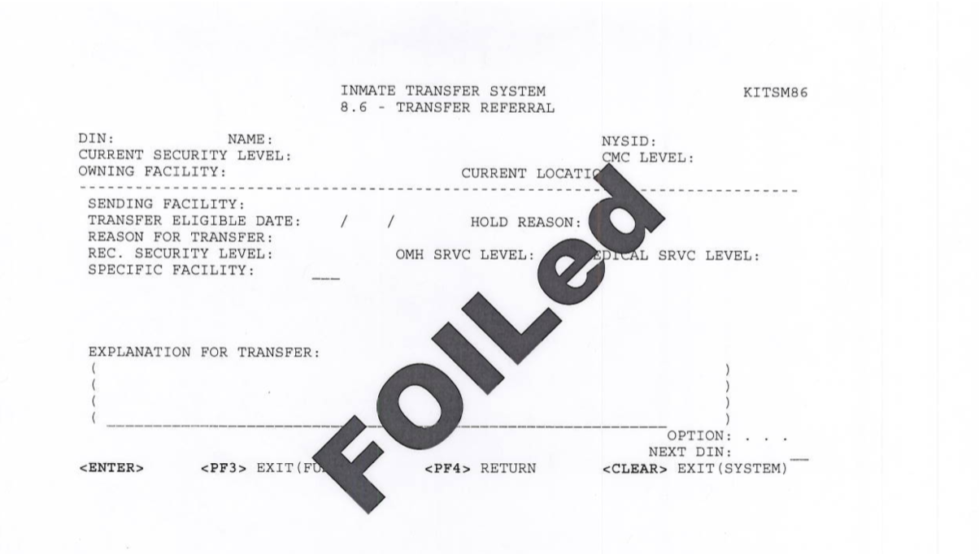
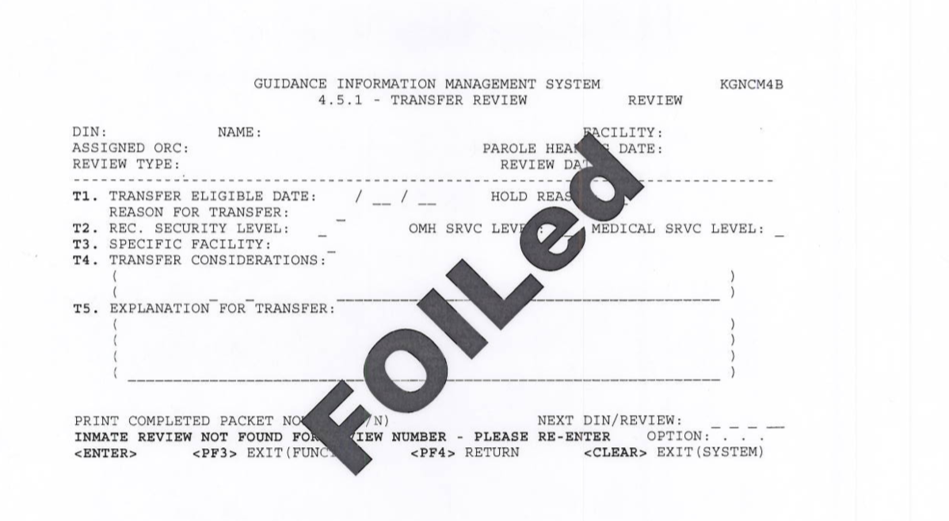
Transfer Logics
Why do people get transferred?
Punitive transfers
  Fight-related
  Ticket-related
‘Paternal’ transfers
  Health-related
  Safety-related
  Classification-related
Requested transfers
  Education-related
  Work-related
Notes:
What is a transfer?
Logics of transfer – ‘official reasons’
But, there are underlying reasons

Slide 9
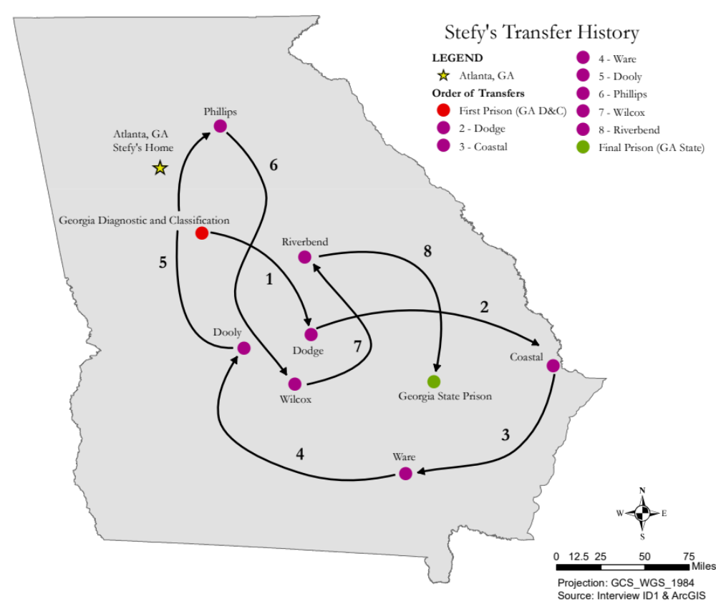
Transfer Logics
Why do people get transferred?
‘Getting too comfortable’
Posing a political threat
Racism, Homophobia, and Transphobia
‘Population Distribution’
“Most of the times they just say, it's just to redistribute you through the system, which makes no sense, to me. Like, why do you need to redistribute people?”
-- Lucille (pseudonym)
Notes:
What is a transfer?
Logics of transfer – ‘official reasons’
But, there are underlying reasons

Slide 10
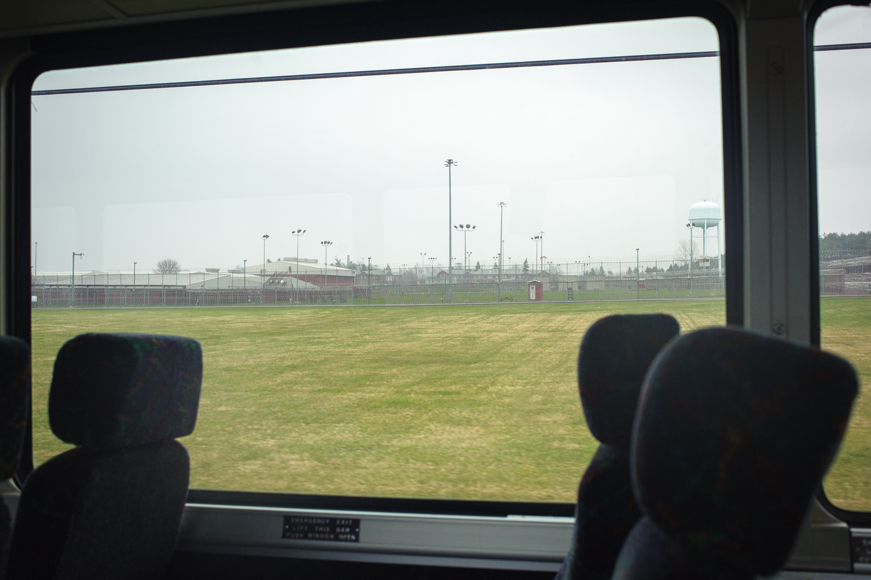
“They want to fill up that van, that bus, whatever they're sending to transport you.”
“All the buses is always packed”
“They always fill the bus up, they never have a seat open, never.”
“The buses are always full!”
Photo Credit: Jacobia Dahm, In Transit (2014)

Slide 11
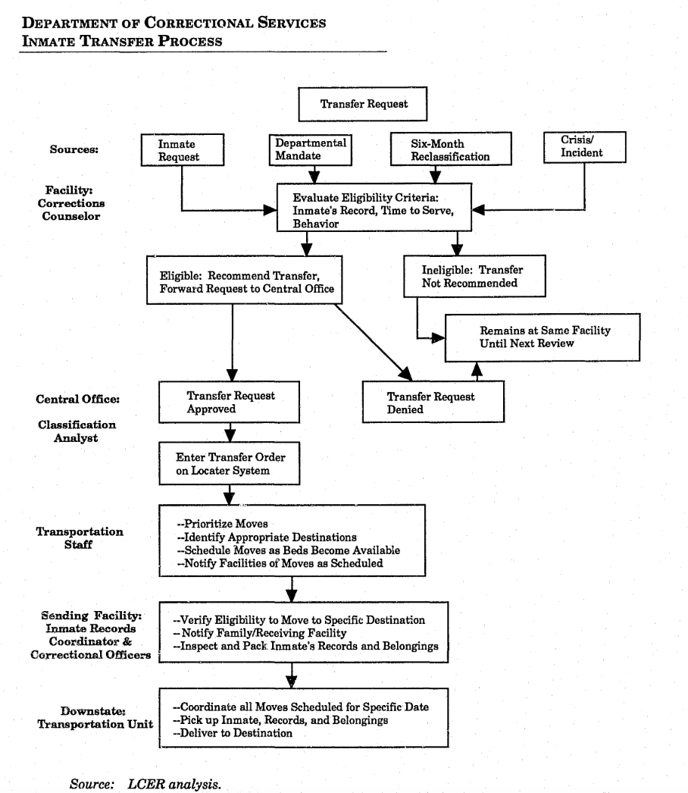
“I get a picture of moving cattle, you know what I'm saying?
-- Lamar (pseudonym)
“You know, I grew up in the cattle business, and I felt very much like cattle…being prepared to be loaded onto trucks and hauled to another location.
You know men and women, just feel like animals…poked and prodded and moved through a very dehumanizing process.”
-- Isaac (pseudonym)

Slide 12
Carceral temporalities
Photo Credit: Curtain, Melvin Edwards (1969), photo by author 11/2018

Slide 13
Rough Timeline of a Transfer
~1:00 am
Waiting Area in Prison 1
Once packed up, the person is brought to a holding cell to wait to board the bus. Usually their stuff is taken and checked.
~2:00 pm
Arrive at Prison 2
The bus arrives at its destination. People onboard wait while the bus is given a security check
~?? pm
Security Check #2
People are strip-searched and go through intake into the new facility
~4:00 am
Boarding the Bus
~?? am
Security Check #1
People are searched before they board the bus
e.g. 10 am
Stops
The bus might stop to pick up passengers, drop people off, or for COs to go to the bathroom or get food
~?? pm
Waiting Area in Prison 2
The bus’s passengers disembark. They often wait before going through security.
~4 pm
Begin Orientation at Prison 2
People begin the orientation to a new prison. Usually they are not in the general population for a period of time.
12:00 am
Transfer Begins
COs arrive at person’s cell and tell them to pack up
Photo Credit: Curtain, Melvin Edwards (1969), photo by author 11/2018

Slide 14
“You know, these officers are not in a rush to get to their location, because it's overtime for them. The longer they're on the road, the more hours they can log in…they're making all these stops”
-- Lamar
Photo Credit: Curtain, Melvin Edwards (1969), photo by author 11/2018

Slide 15
‘just-in-time’ vs. ‘no-time’
Logistics:
Connect prisons into a network
Are always already political
Attempt to produce non-human subjects
BUT, operate under different temporal logics
Photo Credit: Curtain, Melvin Edwards (1969), photo by author 11/2018

Slide 16
“In prison, the sky doesn't even look the same. Like in the prison and out now -- it's like no comparison, it looks completely different!
So, just to be out…you know, everybody is looking out the window” – Shaun (pseudonym)
Photo Credit: Wikipedia
Notes:
“Walls turned sideways are bridges” – Angela Davis

Slide 17
“Walls turned sideways are bridges”
– Angela Davis
Photo Credit: Wikipedia
Notes:
“Walls turned sideways are bridges” – Angela Davis

Slide 18
Thank you!
Acknowledgements: Dr. Asha Best, Dr. Patricia Ewick, the Steinbrecher Fellowship, the Peter Condakes Fellowship, Clark University Student Council, and every person, friend, and organizer who made this project possible and from whom I’ve learned so much.
Notes:
“Walls turned sideways are bridges” – Angela Davis

